Slide 1
THE BIKE RIDING COMPETITIONS

Slide 5
The winners of the competitons, in years 2005-2014, are:
-Ola Szor
-Hania Wojewoda
-Pola Kądzielska
-Florek Gęsina
-Mikołaj Sroczyński
-Jędrek Jakubisiak
-Wojtek Rebejko

Slide 6
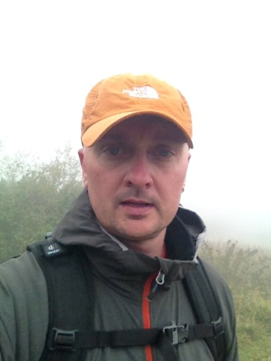
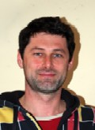
The championships in years 2005-2014 were organized by:
Mr Filip Wojewoda & Mr Piotr Melon.

