Slide 1
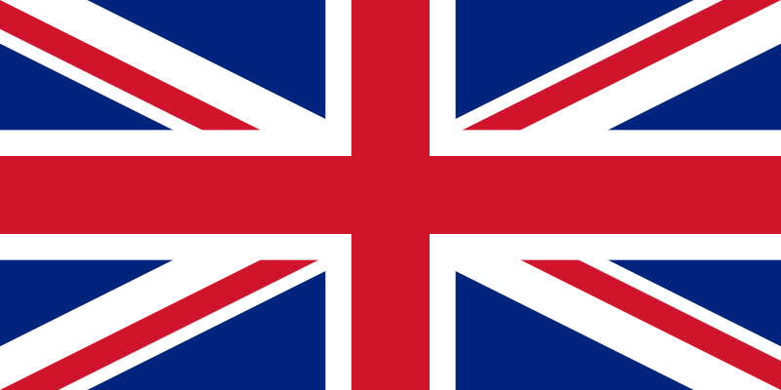
THE UNITED KINGDOM

Slide 2
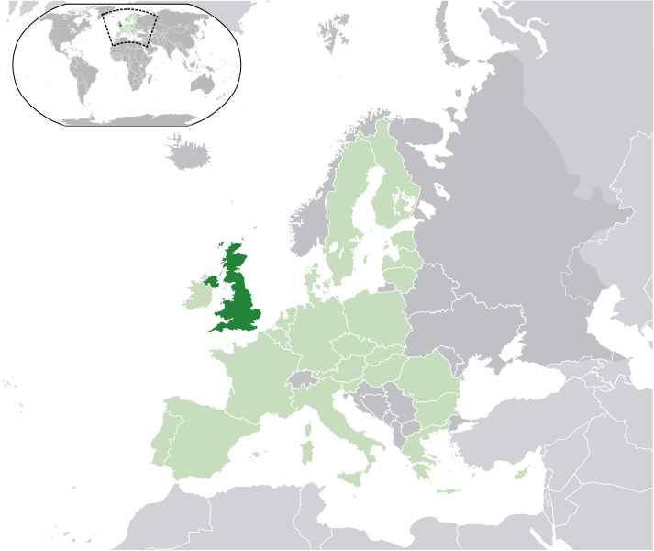
This is the United Kingdom (UK) on the Europe map:

Slide 3
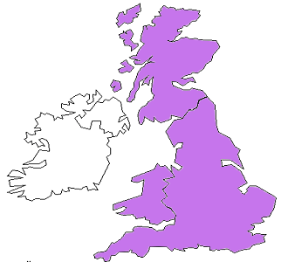
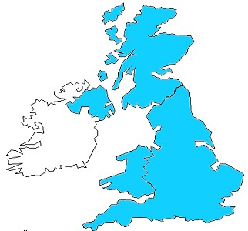
Be careful!
This is GREAT BRITAIN…
…and this is the UNITED KINGDOM!
Can you see the difference?

Slide 4
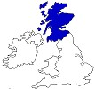
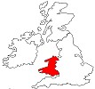
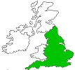
GREAT BRITAIN is composed of 3 countries:
SCOTLAND
WALES
ENGLAND

Slide 5
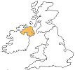
The UNITED KINGDOM is composed of 4 countries:
NORTHERN IRELAND
SCOTLAND
WALES
ENGLAND

Slide 6
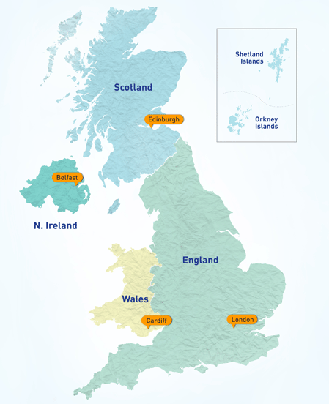
Look at the map.
EDINBURGH is the capital of
SCOTLAND
CARDIFF is the capital of
WALES
BELFAST is the capital of
NORTHERN IRELAND
LONDON is the capital of
ENGLAND
… and of the UK, too!

Slide 7
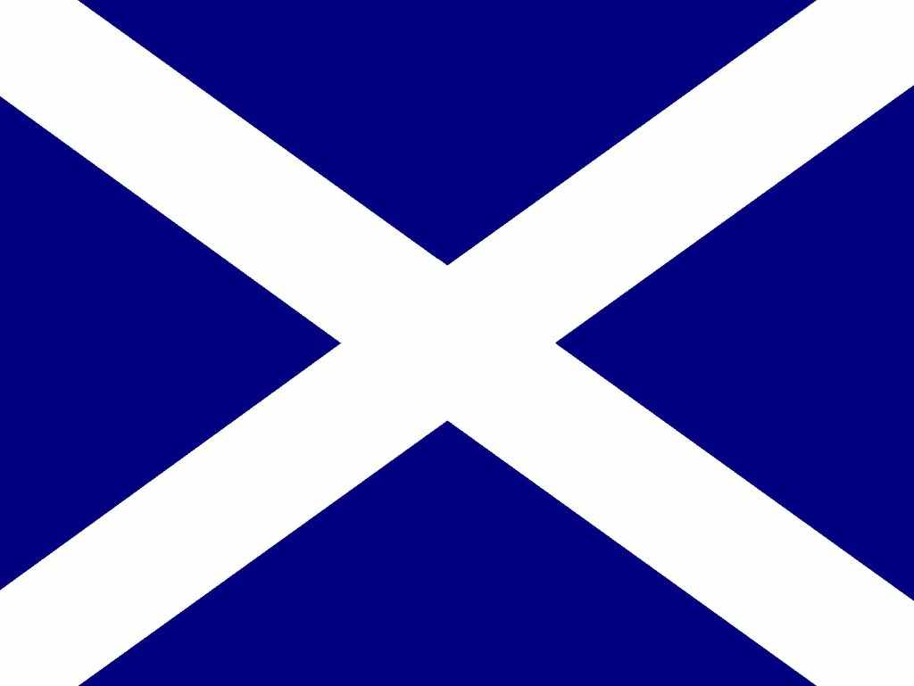
This is the flag of
SCOTLAND
(PATRON SAINT: ST. ANDREW)

Slide 8
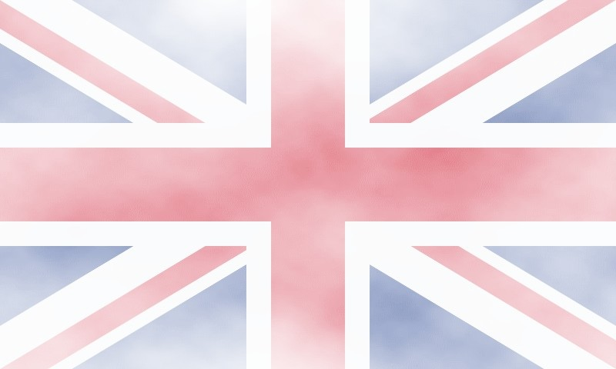
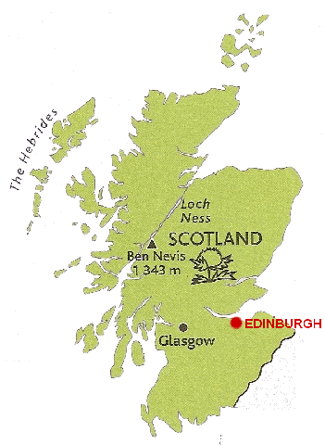

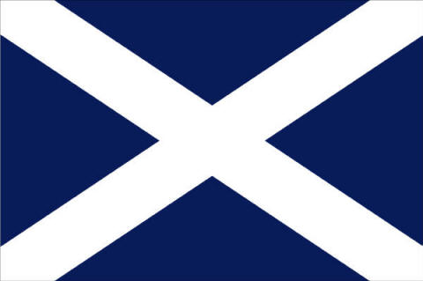
Good morning! My name is Sean. I am from Scotland. I’m Scottish.
The capital of Scotland is Edinburgh.
The thistle is the symbol of Scotland.
The cross of St Andrew is the flag of Scotland

Slide 9
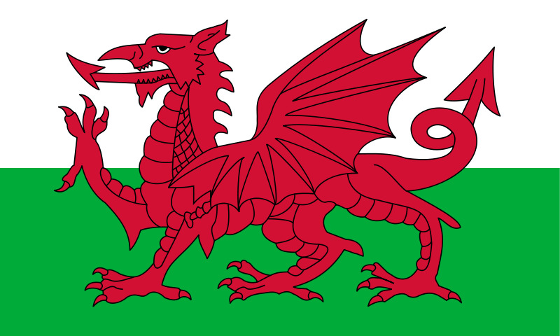
This is the flag of
WALES
(PATRON SAINT: ST. DAVID)

Slide 10
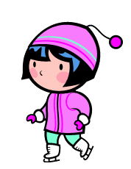

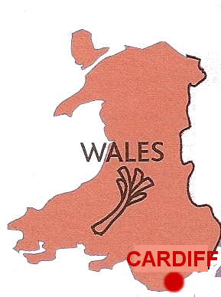

Hi! My name is Mary. I am from Wales. I am Welsh. The capital of Wales is Cardiff
The leek is the symbol of Wales.
The Red Dragon
is the flag of
Wales.

Slide 11
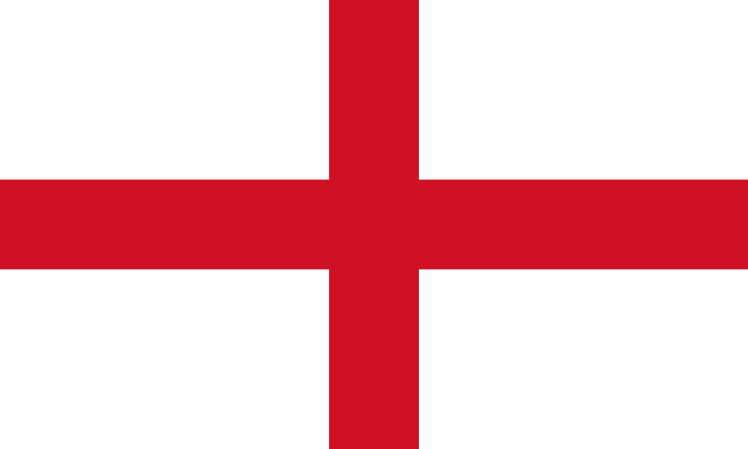
This is the flag of
ENGLAND
(PATRON SAINT: ST. GEORGE)

Slide 12
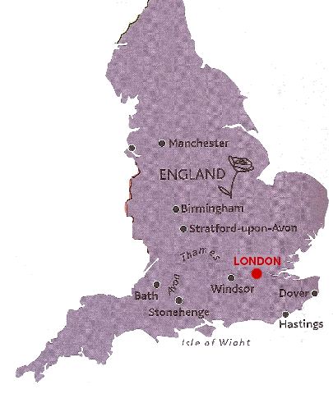
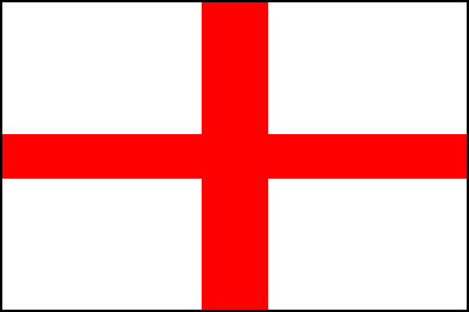

Hello! I am John. I am from England, I’m English.
The capital of England is London.
The rose is the symbol
of England
The flag of England is
The Cross of St George

Slide 13
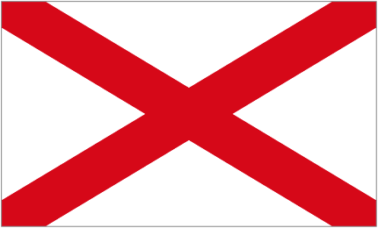
This is the flag of
NORTHERN IRELAND
(PATRON SAINT: ST. PATRICK)

Slide 14

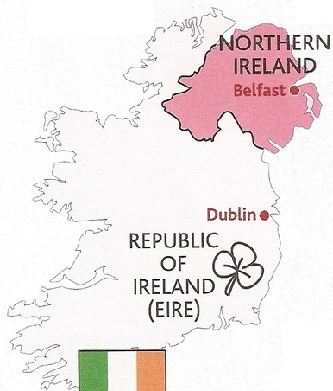

Hi! I am Chloe. I am from Northern Ireland. I am Irish.
The capital of Northern Ireland is Belfast.
Northern
Ireland
is also
called
Ulster
The cross of St Patrick is the flag of Ulster.
The symbol of Northern Ireland is the shamrock

Slide 15
+
+
=
The flag of
SCOTLAND
The flag of
NORTHERN IRELAND
The flag of
ENGLAND
THE UNION JACK
The flag of the UNITED KINGDOM

Slide 16
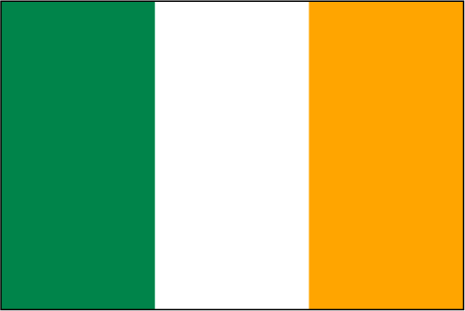
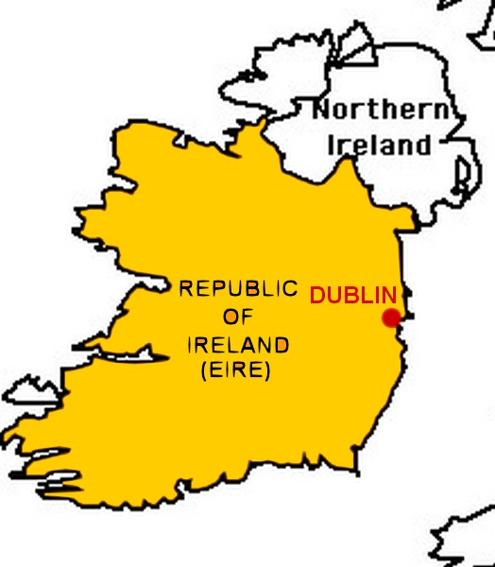
The flag of Ireland is
green, white and orange.
The Republic of Ireland is an independant country! I am Susan and I am Irish.
The capital of Ireland is Dublin. Ireland is NOT part of the United Kingdom!

Slide 17


The government of the United Kingdom is the MONARCHY.
The national anthem is GOD SAVE THE QUEEN / KING.
God save our gracious Queen,
Long live our noble Queen,
God save the Queen!
Send her victorious,
Happy and glorious,
Long to reign over us,
God save the Queen!
O lord God arise,
Scatter our enemies,
And make them fall!
Confound their knavish tricks,
Confuse their politics,
On you our hopes we fix,
God save the Queen!
Not in this land alone,
But be God's mercies known,
From shore to shore!
Lord make the nations see,
That men should brothers be,
And form one family,
The wide world ov'er
From every latent foe,
From the assasins blow,
God save the Queen!
O'er her thine arm extend,
For Britain's sake defend,
Our mother, prince, and friend,
God save the Queen!
Thy choicest gifts in store,
On her be pleased to pour,
Long may she reign!
May she defend our laws,
And ever give us cause,
To sing with heart and voice,
God save the Queen!

Slide 18
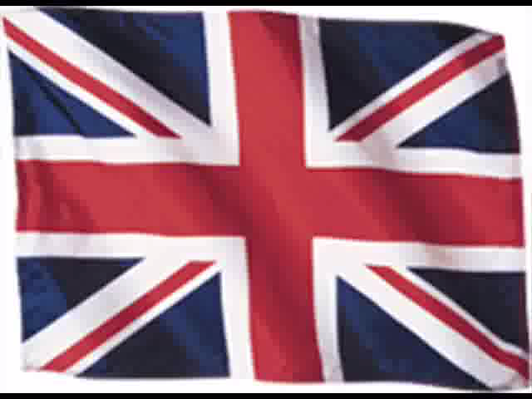
The national anthem GOD SAVE THE QUEEN / KING

Slide 19
THE UNITED KINGDOM

Slide 20
The UNITED KINGDOM is composed of 4 countries:
NORTHERN IRELAND
SCOTLAND
WALES
ENGLAND

Slide 21
GREAT BRITAIN is composed of 3 countries:
SCOTLAND
WALES
ENGLAND

Slide 22
Scotland
The capital of Scotland is Edinburgh.
The cross of St Andrew is the flag of Scotland.
The thistle is the symbol of Scotland.

Slide 23
Wales
The capital of Wales is Cardiff
The Red Dragon is the flag of Wales.
The leek is the symbol of Wales.

Slide 24
England
The capital of England is London.
The flag of England is the Cross of St George.
The rose is the symbol of England

Slide 25
Northern Ireland
The capital of Northern Ireland is Belfast.
The cross of St Patrick is the flag of Ulster.
The symbol of Northern Ireland is the shamrock.
Northern Ireland is also called Ulster.

