Slide 1


How can we make a film?
Dorota Cichocka

Slide 2

Start
At the beginning you must chose the topic of your film. The topic is something you will make film about. When you chose the topic you need inspiration.

Slide 3

Topic
In the second step you must get to know all about your topic. Then you need to have a director.
Topic

Slide 4

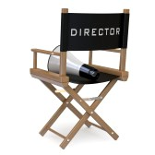
Director
The director is an author of the artistic concept art, inspiring colleagues and directing them. The director is responsible for the whole movie.
He will chose costumes, a place to record movie and many other things. Then you must write a screenplay.

Slide 5
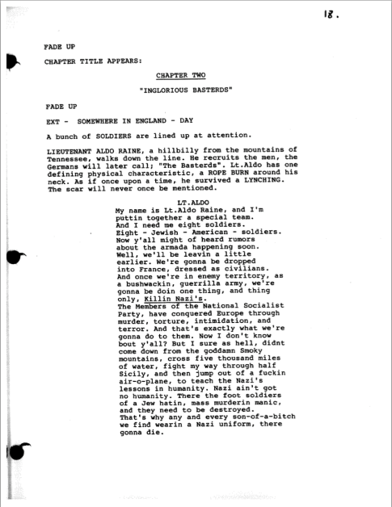
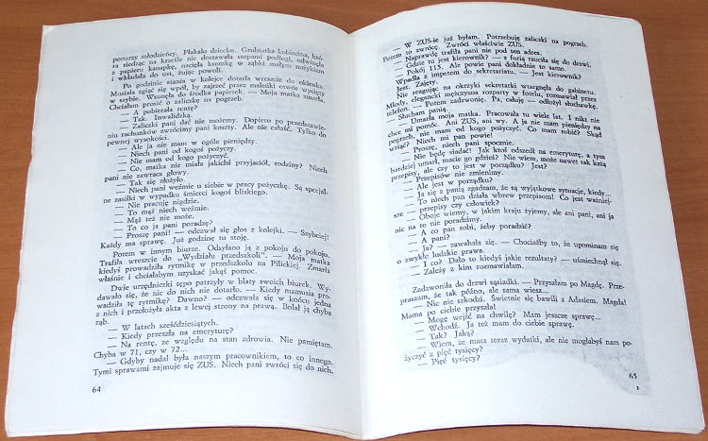
Screenplay
In your screenplay you have to use dialogues and you must write all about the time and places of each scene. You need to write when the actors enter and exit from the scene.

Slide 6
Arrangements
Now you need to prepare actors and scenes. Many people will help you:
    Makeup man
    A person practicing diction
    Stage designer
    Sound engineers
    Composer
    Sometimes animal trainers

Slide 7
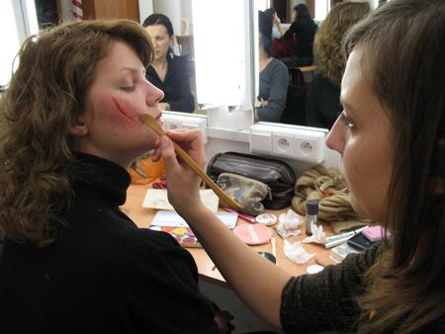
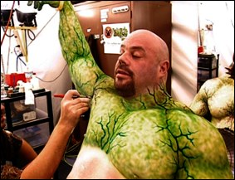
Makeup man
It’s a profession consisting in changing the actor’s face and body to show his/her character in the film.

Slide 8

    A person practicing diction
Person who helps you in problems with diction. That person teaches you how you can speak correctly.

Slide 9
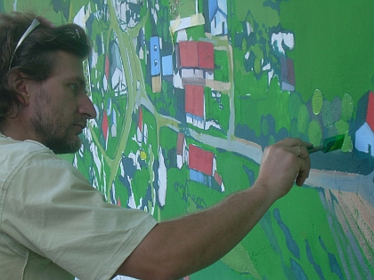
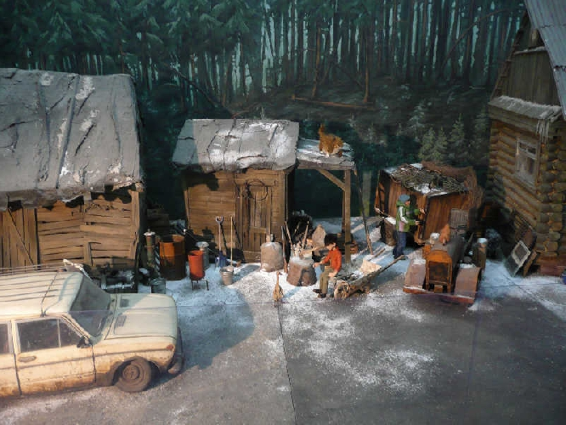
Stage designer
His job is to prepare props, costumes, lights and decorations.

Slide 10

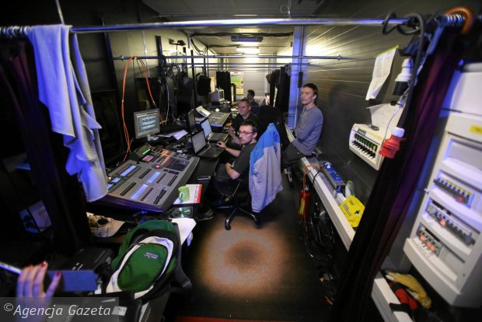
Sound engineer
His job is to prepare music and sounds for a film.

Slide 11
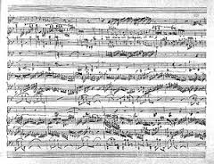
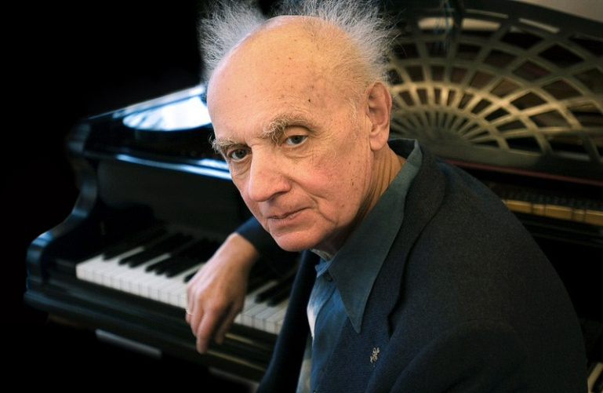
Composer
Composer is a person who creates and composes music. Music created by composer appears in the film.

Slide 12

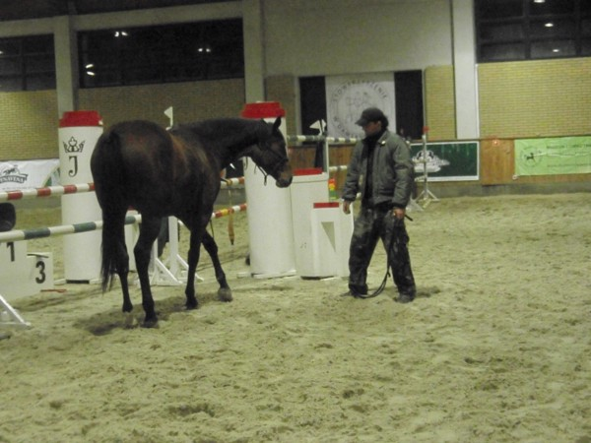
Animal trainer
The main goal of the animal trainer’s work is to prepare and accustom the animals to certain behaviors in certain situations and teach them to obey.

Slide 13
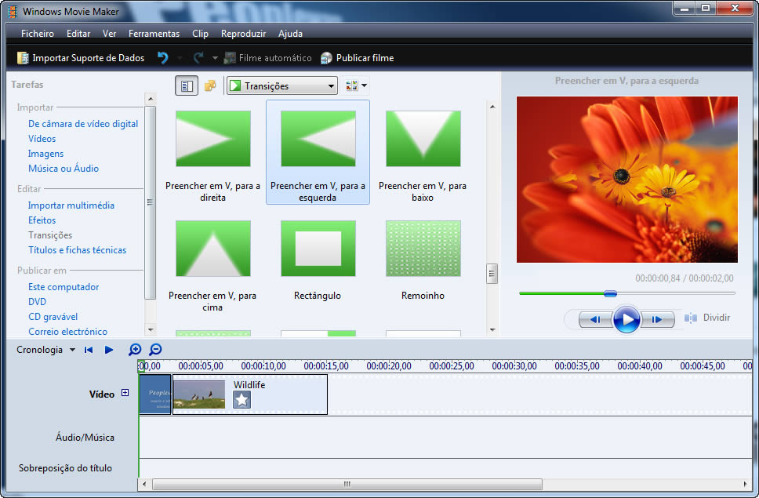
Assembly - last stage
Assembly is technical issue, during this stage different scenes are connecting together. Movie Maker is an example of program which can help you to assembly the film.

Slide 14
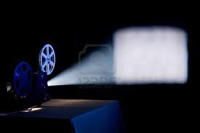

The end

