Slide 1
Fashion of eighties

Slide 2
Clothes
People wore colorful clothes. They wore thin trousers like leggins, which were mixed with skirts. They also wore mini skirts and jeans. Skirts, dresses were made from denim and bright coloured materials. Women loved spottet and striped trousers. We can’t forget about thin trousers with crease. They wore wide tops and T-shirts with printed design.

Slide 3
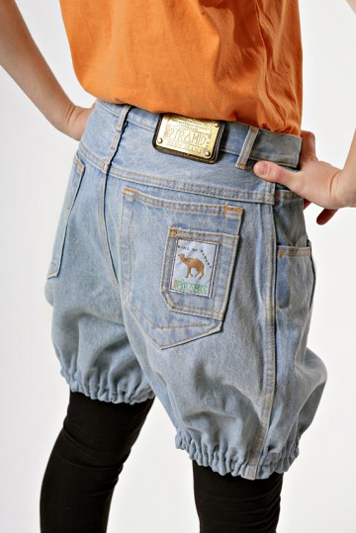
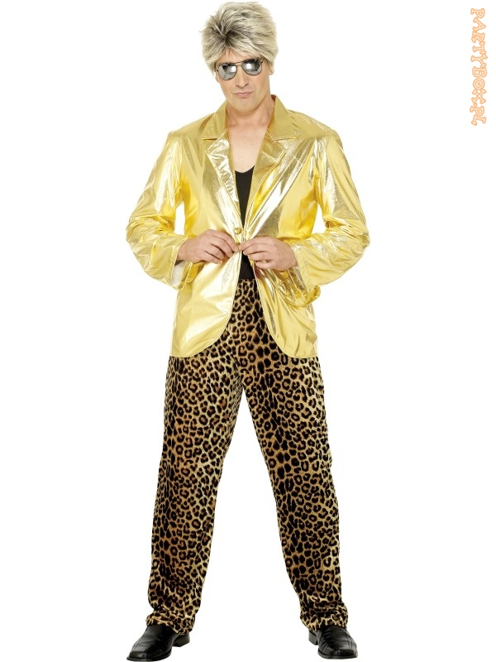

Slide 4
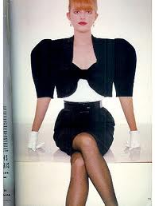
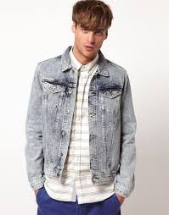

Slide 5
Gadgets and shoes
Bracelets, earrings, necklace, big bandages, bows, and gloves. All of them were very popular. People prefered black crosses and habnails.
People wore colorful shoes. Painted high-heeled shoes, flat parameciums with asymmetrically patterns, plimsolls.

Slide 6
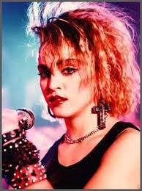
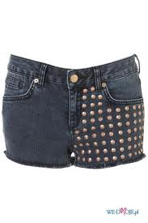

Slide 7
Hairstyles
In eighties people thought that if they have a lot on head, this is good. People liked big hairstyles. They use a lot of hair gel.

Slide 8
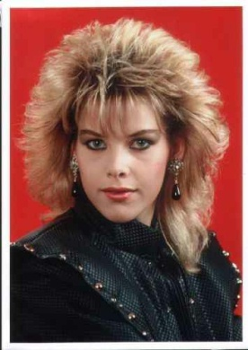
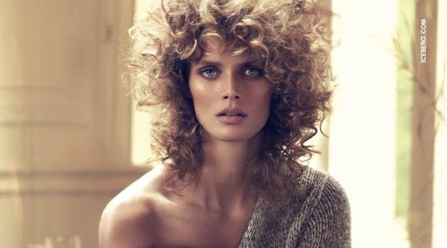
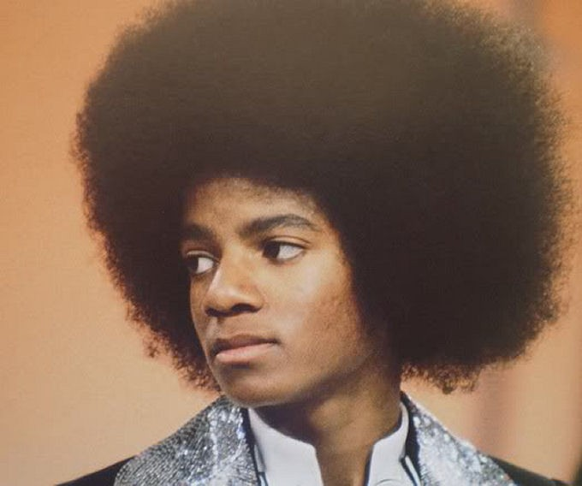

Slide 9
Idols
People patterned theirs clothes upon music and film stars, for exapmle: Madonna, Limahl, Michael Jackson.

Slide 10
