Slide 1
Diseases
Mateusz Wójcik

Slide 2
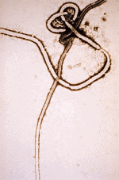
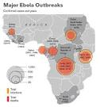
Ebola
The dangerous disease infectious.
It is spread in Africa.
It is spread by droplet route.
The virus of Ebola is a haemorrhagic fever virus.
There isn’t any cure for Ebola.

Slide 3
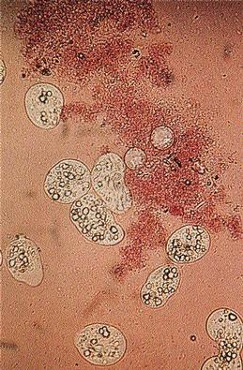
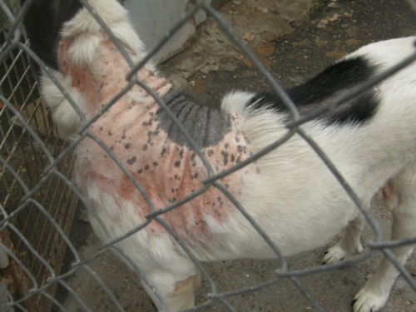
Typhoid
The dangerous infectious disease.
It is often spread in warm countries.
It is spread like black death by fleas.
Typhoid is a bacterial disease.
The symptom is red spots on the body
A Polish doctor invented a vaccine.

Slide 4
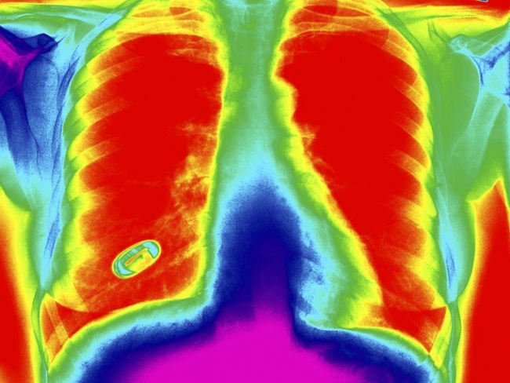
Tuberculosis
The dangerous infectious disease.
The infection is spread by air.
The symptoms are breathing problems.
There is a cure for it.

Slide 5
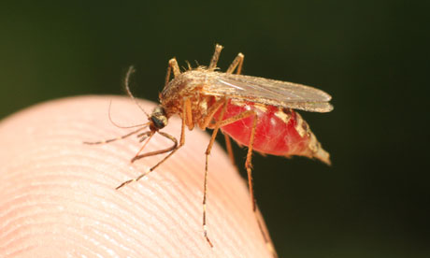
Malaria
There are five types of parasite.
It is spread by mosquitoes.
It is a very dangerous infectious disease. It usually ends with the death.
Symptoms are fever headache, stomachache, vomiting.

Slide 6
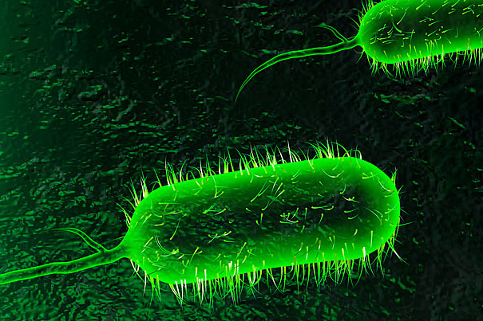
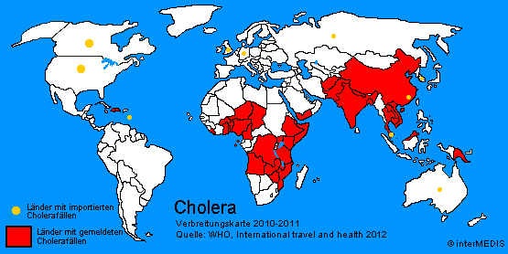
Cholera
The dangerous infectious disease.
It is spread by water.
Symptoms: headache, stomachache, vomiting.

