Slide 1
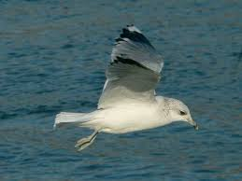
Visit to Sweden October 2013
Patryk Załuska

Slide 2
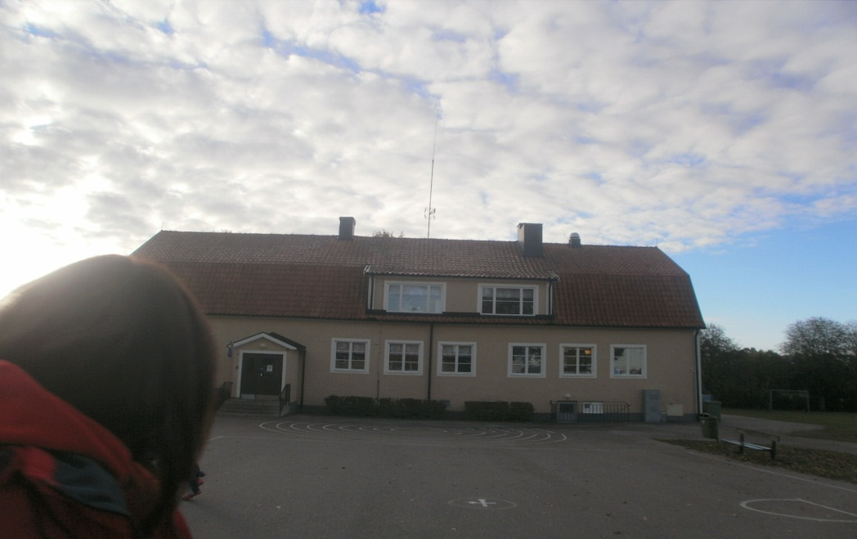
Two weeks ago I was in Sweden, in Linshoping. With me there were : Jakub, Max, Paulina, Nela, Natalka, Jula,Ola, Amelka and Zuzia. The first day when we arrived we played a match with England. We won! 6:5. Later we ate lunch. It was delicious!☺ I ate lazagne, salad and nuggets. Later we went to our hostel. The hostel was great! It had everything. Then I went to sleep.
DAY 1

Slide 3
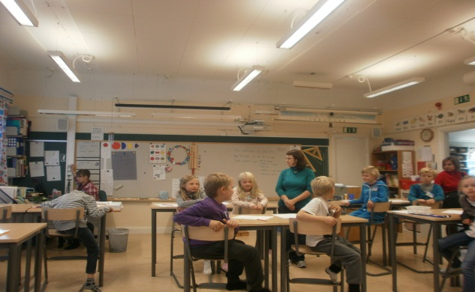
Day2
The next day we got up at 6:30. I was very tired. We ate breakfast and went to the school. We arrived by bus. The school was very big. It had 5 buildings. The guides showed us around. Later we went to the classes and we were doing painting.. After lunch I went to play football. The weather was fine. We went to the old town. Later we came back to Slaka school . We had a disco there. It was good fun..

Slide 4
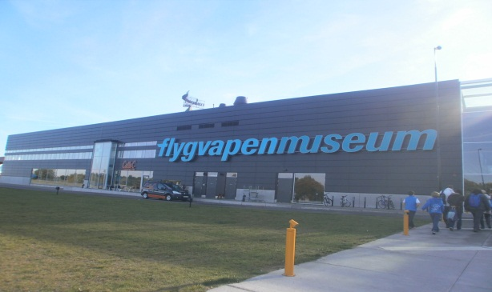
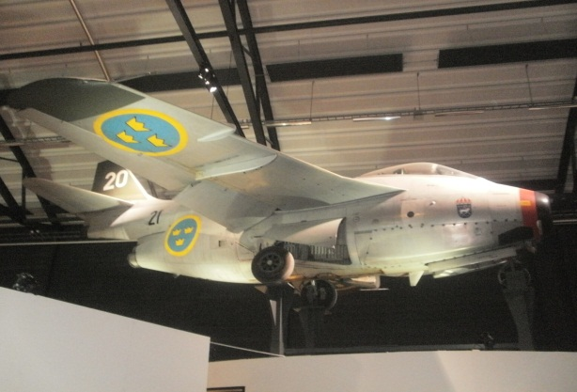
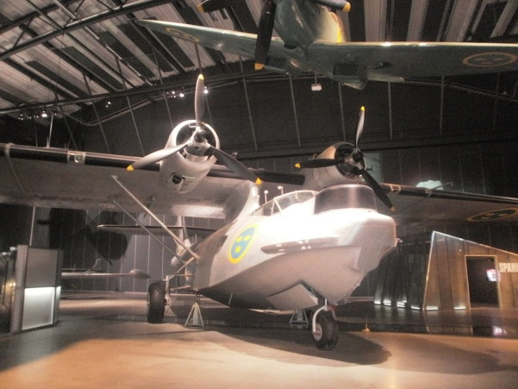
DAY3
On Friday we got up at 6:00. After breakfast we went to the school and did our presentations. After that we went to an Air Force Museum . There were a lot of different planes there. Then we ate dinner and waited for the families to collect us. We went to their house in the countryside where we had a delicious supper. After supper we played on the Play Station. At 21:00 we went back to the hostel

Slide 5
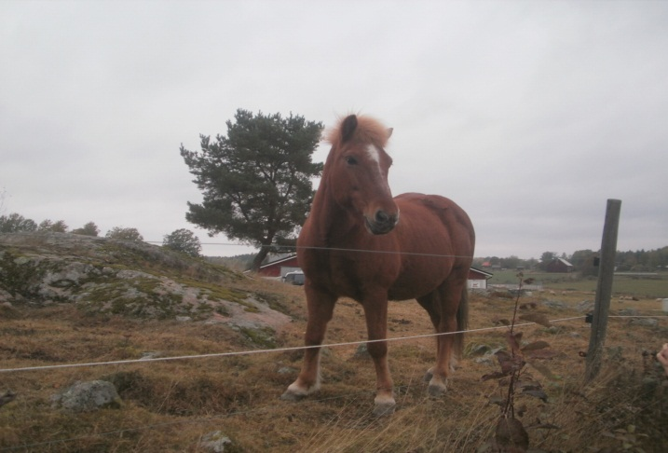
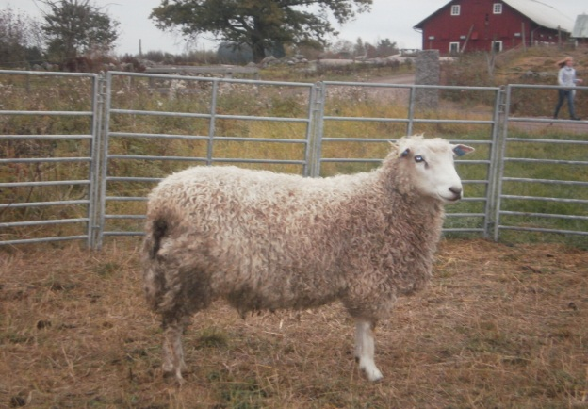
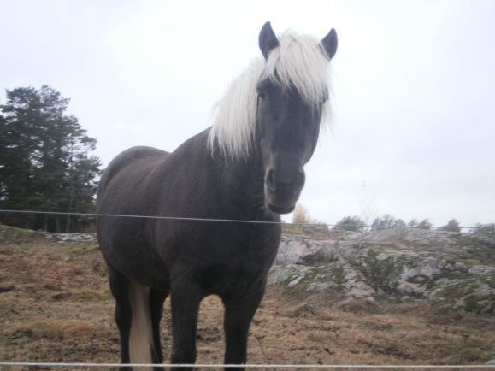
day4
On Saturday we slept until 8:00. In the morning we went to the local town square and met all the other groups.. We had a long walk around the town. There were lots of lovely buildings and we did some shopping. In the afternoon we went to see some local caves. In the caves it was very dark and the caves were very small. Later we visited a big farm with horses and sheep. Then we ate our last lunch in Sweden☹

Slide 6
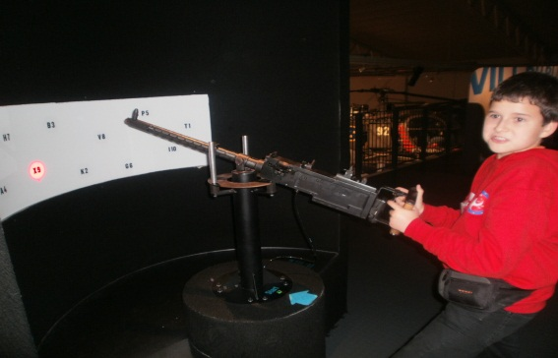
Day5
On Sunday morning after breakfast we packed our bags and went to the airport. We were all very sad that our trip was over.☹
I loved Sweden - the country, the people, the food and even the schools were great!
I hope to go back to Sweden again sometime when I am older.

Slide 7
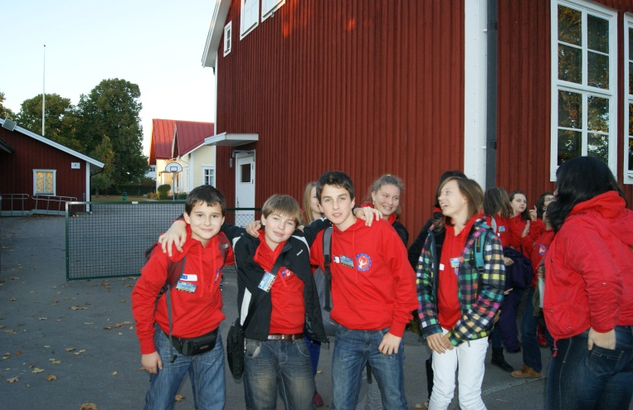
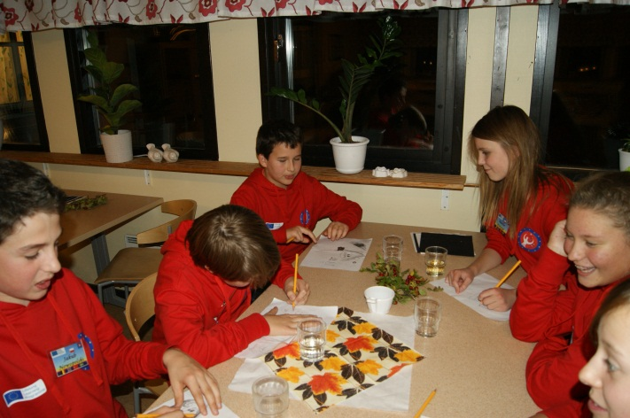
our pictures
A picture of our Polish group
Playing bingo with the pupils

Slide 8
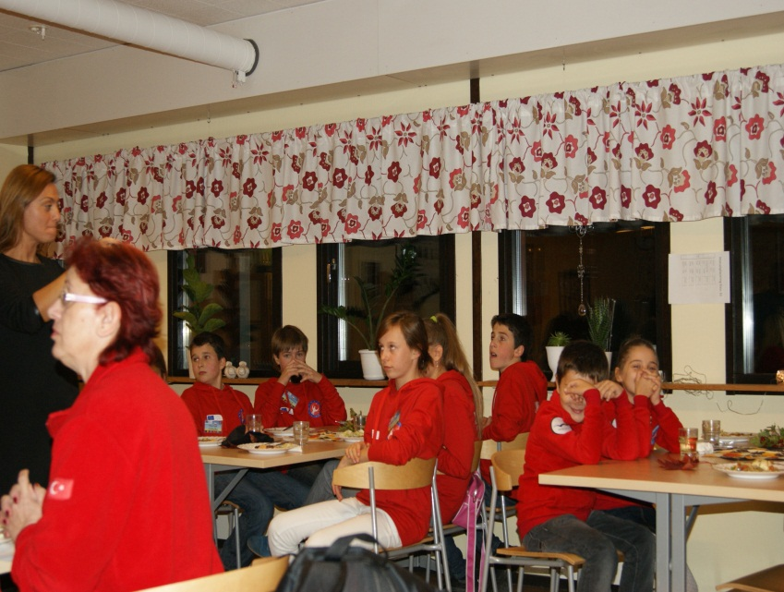
☺
Listening to the school principle
Nice sheep ☺

Slide 9
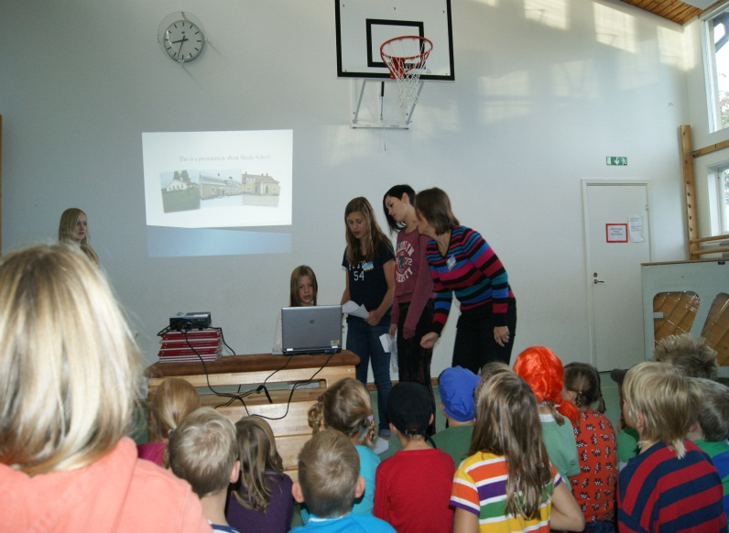
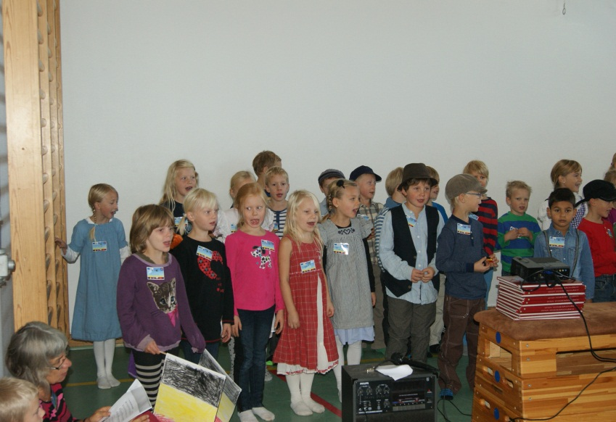
☺
A presentation by Swedish pupils
Swedish pupils singing

Slide 10
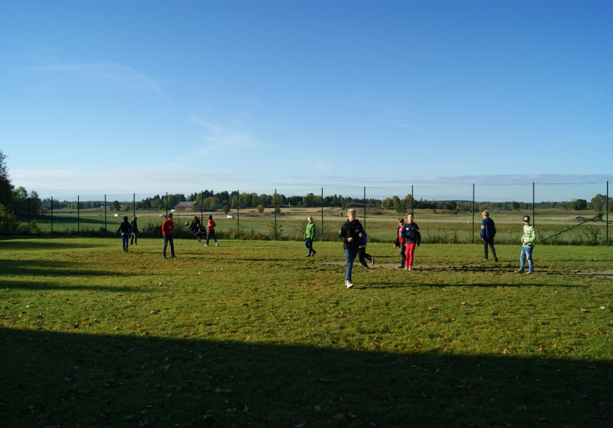
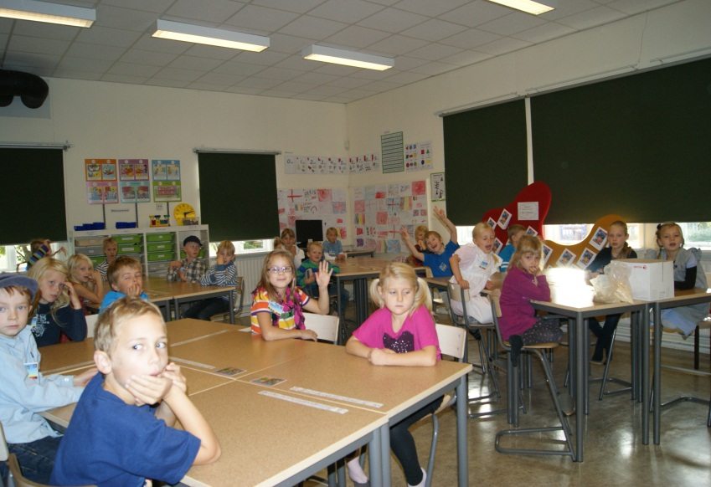
☺
Playing football
A classroom

Slide 11
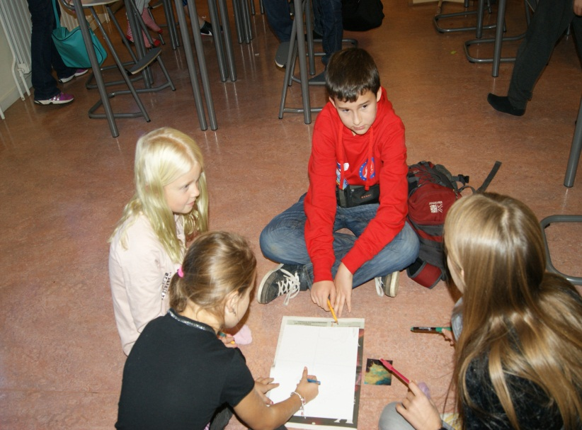
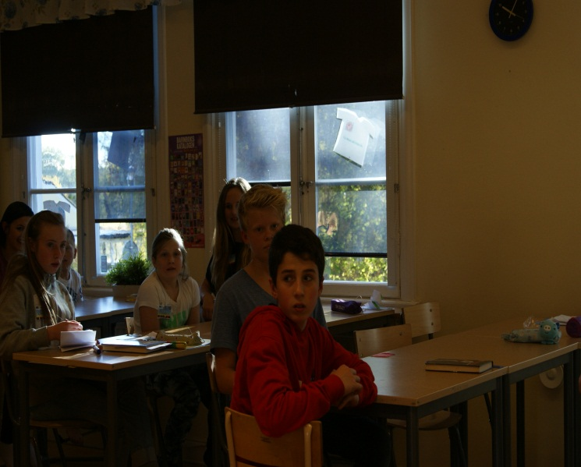
☺
Drawing a picture
Where am I ?

Slide 12
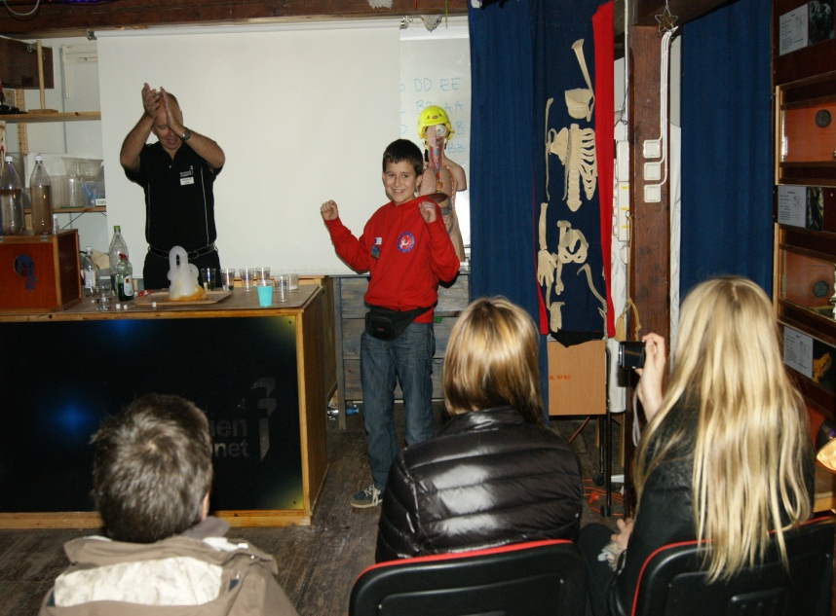
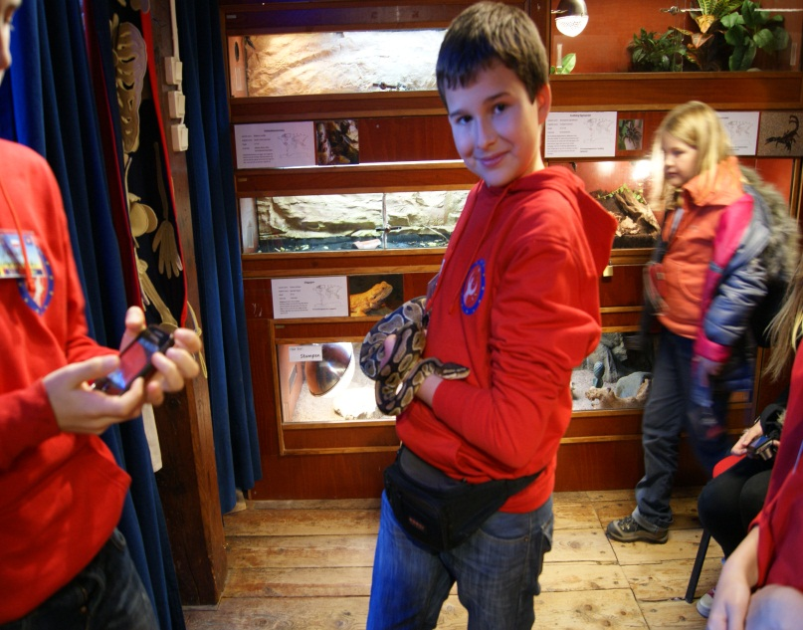
☺
Experiment
Holding a snake

Slide 13
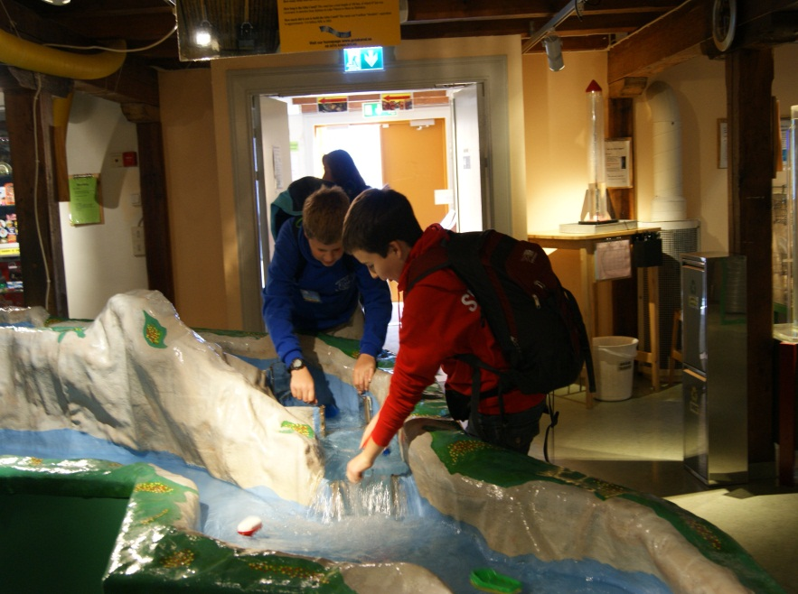
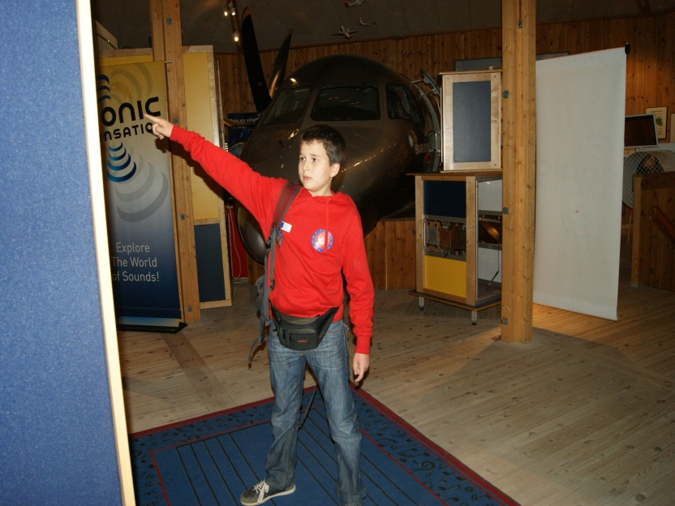
☺
Playing with water
I am the boss!

Slide 14
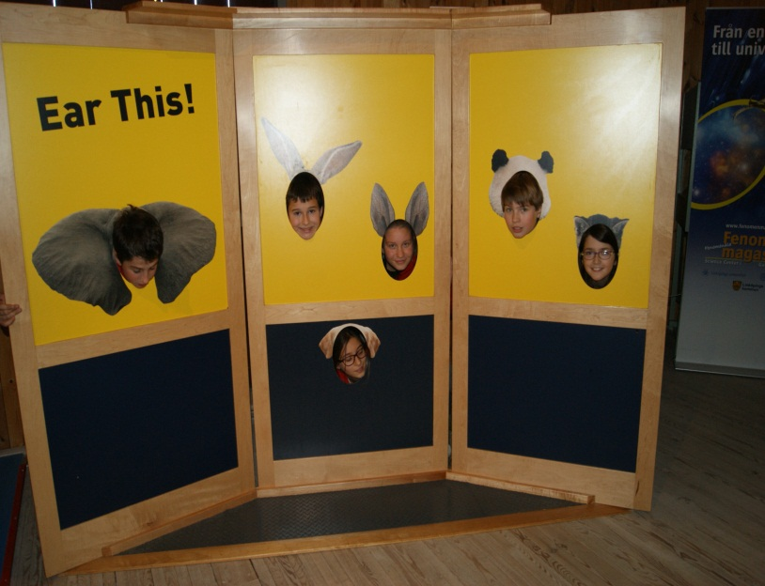
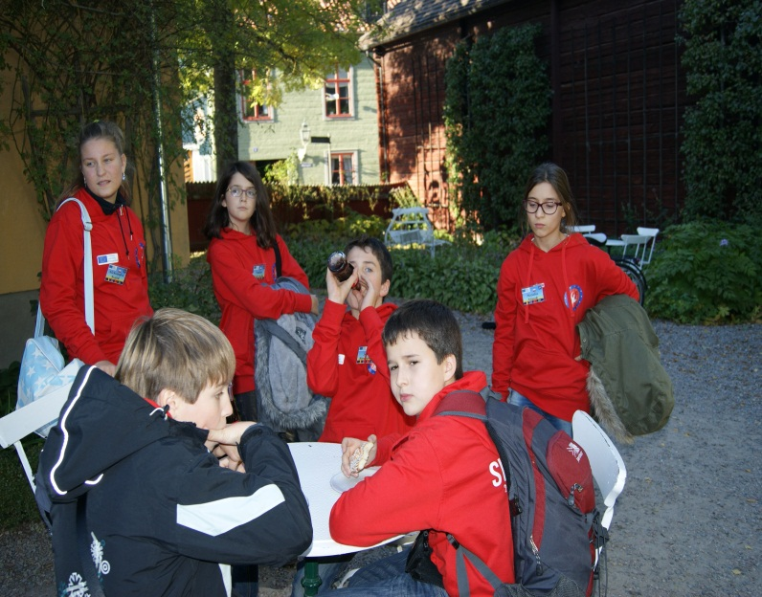
☺
Messing around!
Having a rest

Slide 15
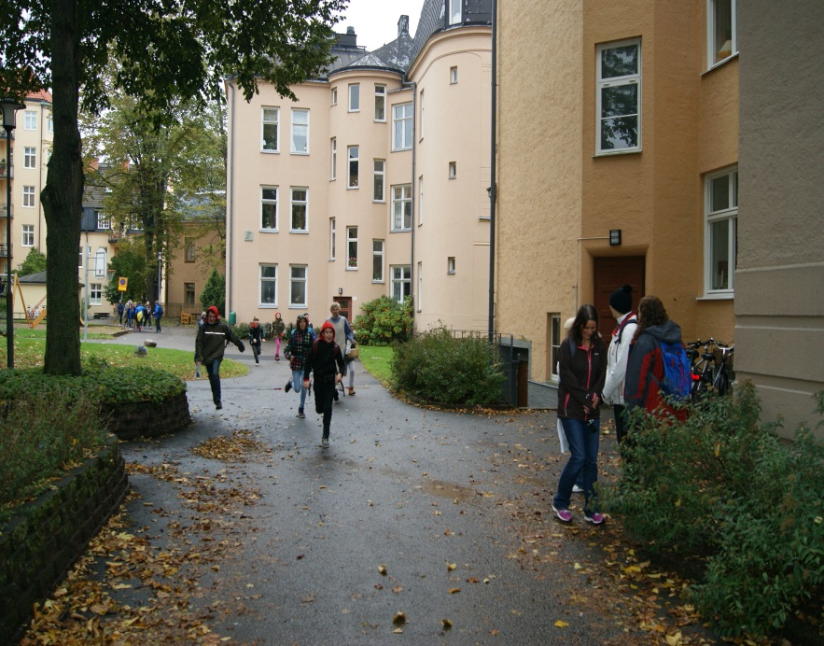
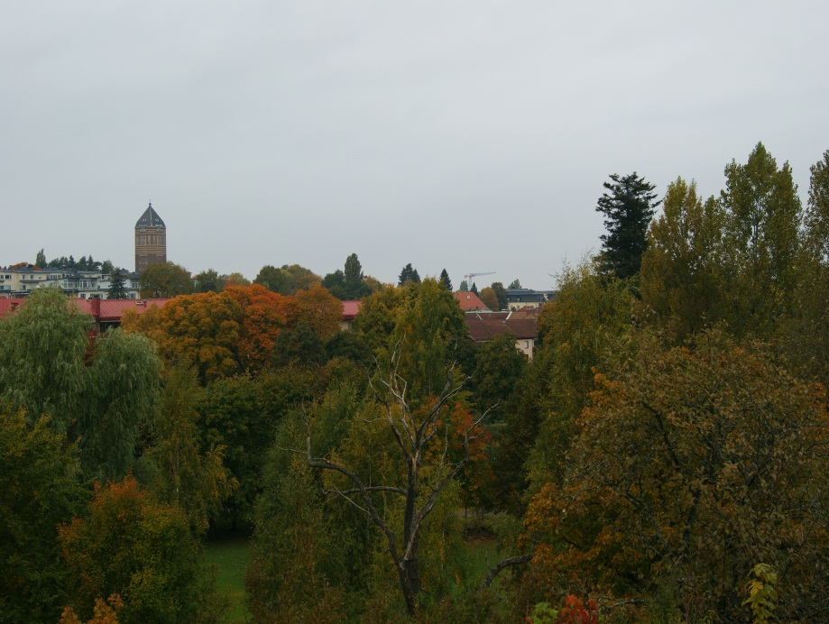
☺
Having a race
The city

Slide 16
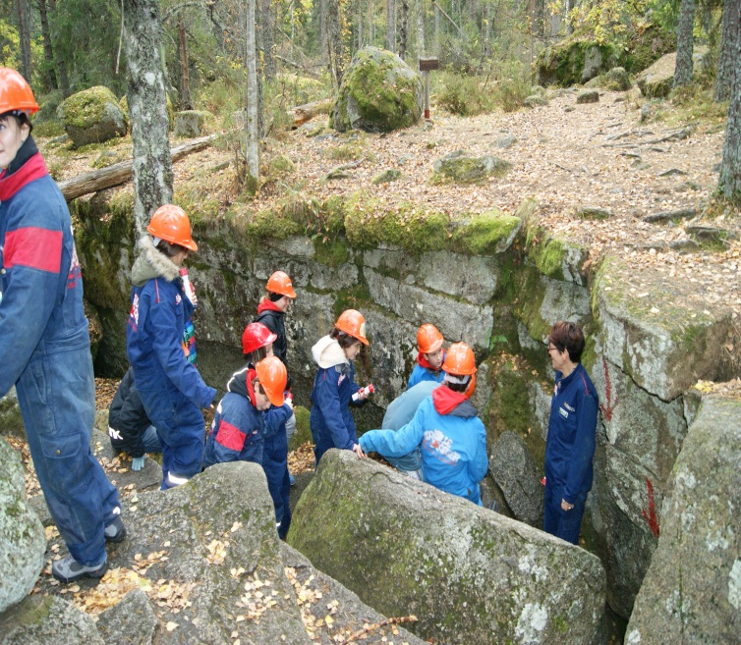
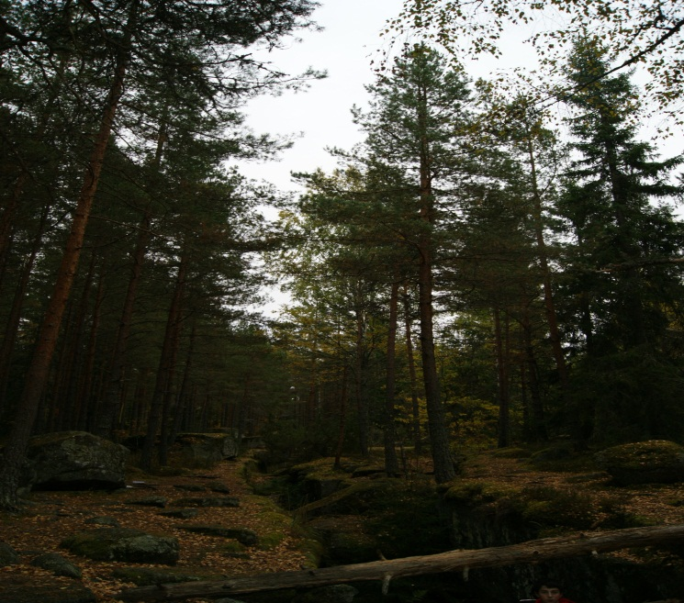
☺
The caves
The forest

Slide 17
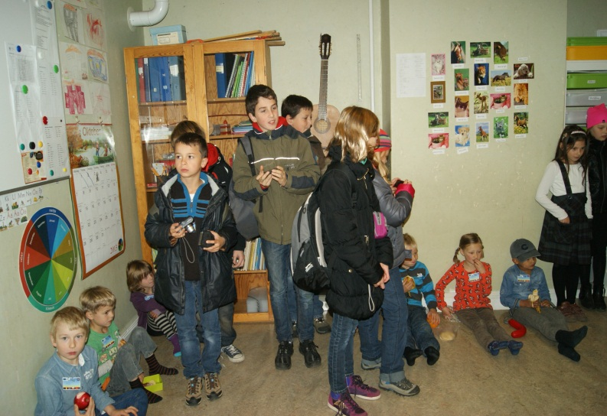
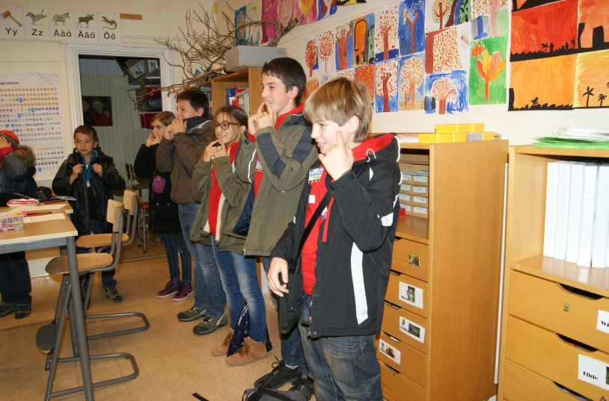
Thanks for listening

