Slide 1
TO PUNCH

Slide 2
TO SLAP

Slide 3
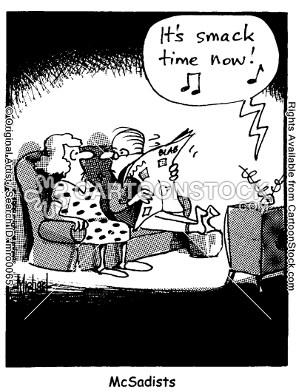
TO SMACK

Slide 4
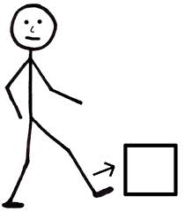
TO KICK

Slide 5
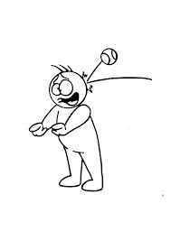
TO HIT

