Slide 1
Filming
Mateusz Wójcik

Slide 2
Inspiration
At the beginning there must to be an idea for film - the idea for the script.
Typically, the script is based on the book, but sometimes the screenwriter decides what the script is about and the film director decides how the film will be done.

Slide 3
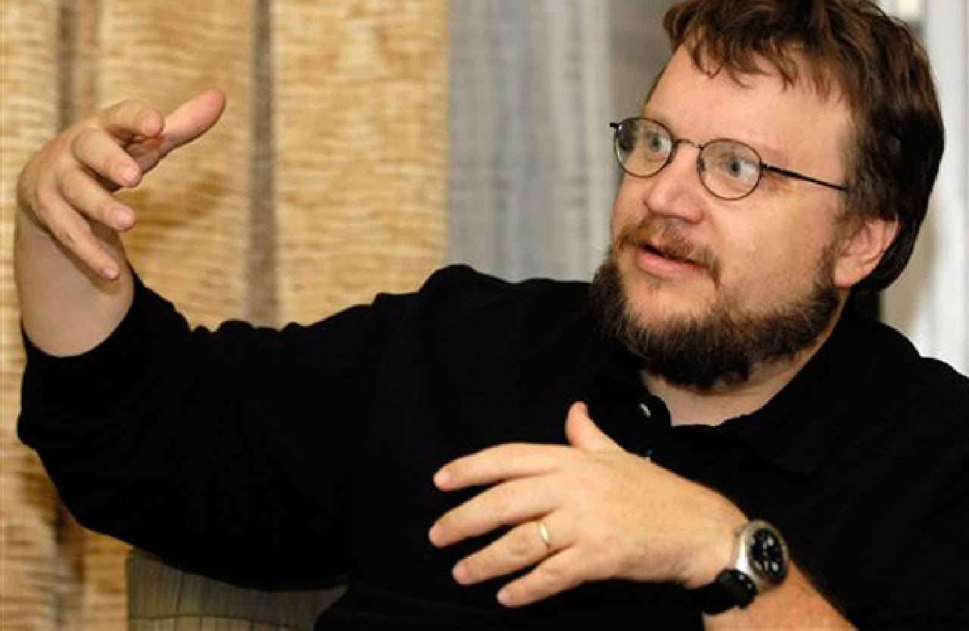
Arrangements
First film producer provides the director with a budget to enable him to do the film.
The film director must have a vision of the film The director has a lot to do: he needs to hire actors and equipment, choose costumes, look for places, music ect.
He must look for Leading Actors, Supporting Actors and extras.

Slide 4
Action
Director has got a lot to do when he starts filming.
He has to direct the filming and manage everybody and everything. He manage cinematographer, production manager, production designer, makeup artist, editor, and many other.
He must manage getting permissions to film scenes in public places. He must travel from place to place with actors costumes and all others. He must rent as well film studio.
He must cooperate with music composer a person who create the music for his film.

Slide 5
Music
But who hear about the film without a music? During the action scenes the energetic music is added. From some film is the special music it is composed specially for the given film only.

Slide 6
Special effects
When Director want to make some scenes with special effects like jumping outside the window he must rent a stuntmen. Next computer technicians may even change the face of stuntmen to the face of a film hero.

Slide 7
Film ending
At last, when all scenes are filmed he must work with film editor to create a final version of the film
When the film is finished it is shown to the film producers, sponsors and distributors.
If the distributors like the film they want to get it to be shown in the cinemas around the world.

Slide 8
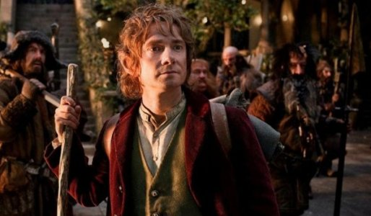
Cinema
If the film is very good the producer sell it to cinemas as well on DVD or TV stations.

Slide 9
Example of special effects in film „Lord of the rings”

