Slide 1
ROMAN POLAŃSKI
JULIA KULPA

Slide 2
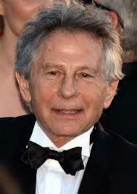
About ROMAN Polański
Director, actor, Roman Polański, was born on the 18th of August 1933 in Paris. At the age of three, Polański moved with his family to Kraków, because his father came from Kraków. In 1954, Polański enrolled at the Polish National Film Academy. In 1962, he directed his first film “Knife in the water”. In 1968, he moved to Hollywood and there he directed “Rosemary’s baby”. In 2002 he directed “The Pianist” and won the Oscar.

Slide 3
ROMAN Polański’s BEST KNOWN Films
Rosemary’s Baby
Chinatown
Repulsion
Knife in the Water
Tess
Frantic
Pirates
The Pianist

Slide 4
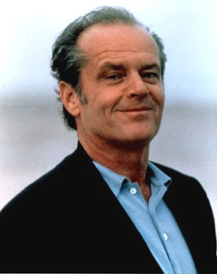
WELL KNOWN ACTORS WHO PLAYED IN POLANSKI’S FILMS
Mia Farrow
Jack Nicholson
Faye Dunaway
Catherine Deneuve
Hugh Grant
Emmanuelle Seigner
Johnny Deep

Slide 5
private life of polaŃski
Roman Polański had three wives:
1.Barbara Kwiatkowska (1959 – 1962; divorced);
2. Sharon Tate (1968 - 1969; she was murdered);
3. Emmanuelle Seigner (from 1989).
He has two children:
Daugher Morgane
Son Elvis

Slide 6
THE END

