Slide 1
HOW CAN WE MAKE A FILM
ABOUT OURSELVES?
ANIA SULIK

Slide 2
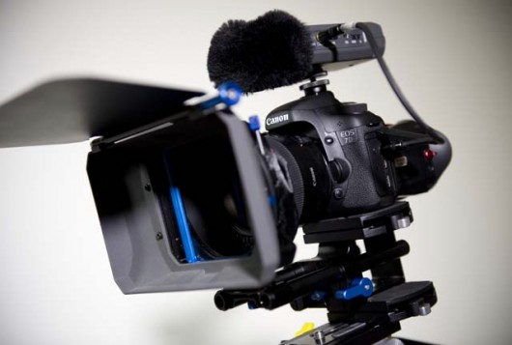

Windows Movie Maker is an important part of Windows that allows you to create home movies and slide shows on your computer, complete with professional-looking titles, transitions, effects, music, and even narration.

Slide 3
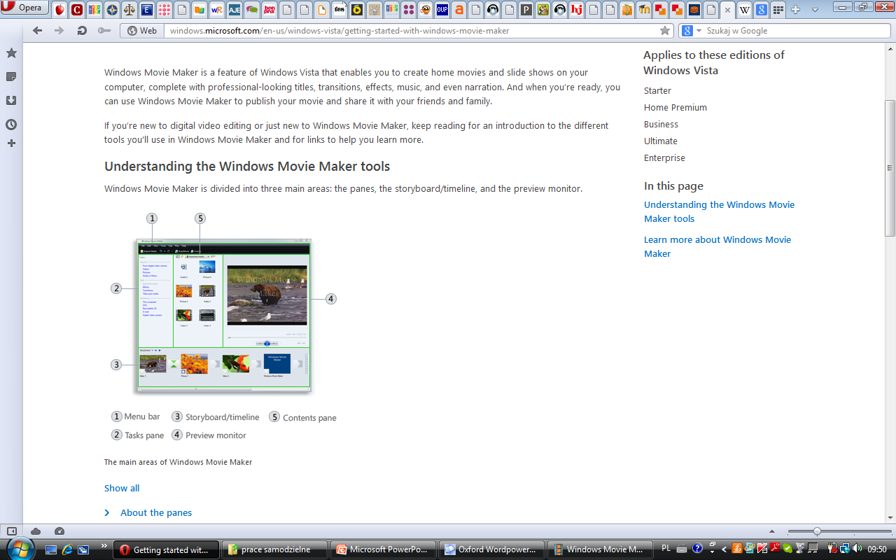
Windows Movie Maker: main areas
panes
Windows Movie Maker is divided into three main areas:
the panes,
the storyboard/timeline,
the preview monitor.
Preview monitor
Storyboard/timeline

Slide 4
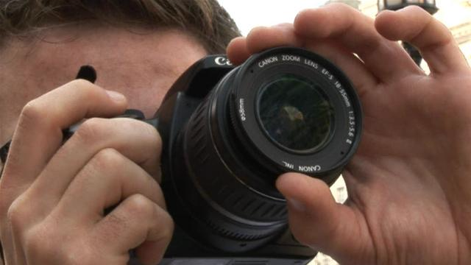
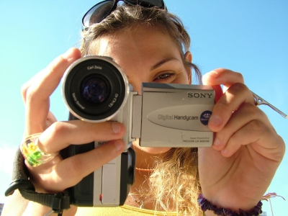
Step by step instructions:
about the panes
First we take some photos and make videos.

Slide 5
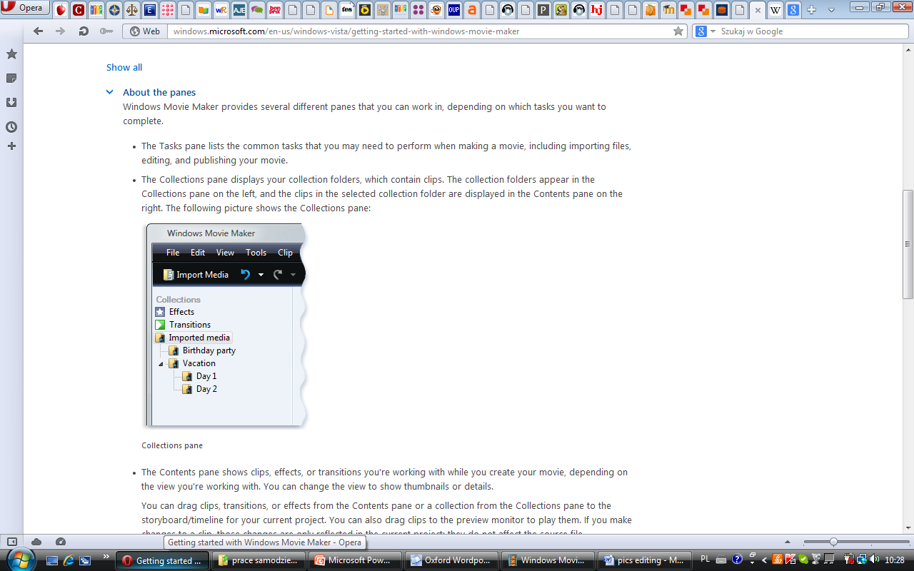
Step by step instructions: about the panes
Then we put them into movie maker programe
When adding your photos and videos, you have a few options.
If you are starting a new project, you can add content by clicking Drag videos and photos here or click to browse for them. Or, you can click Add videos and photos on the Home tab in the ribbon.

Slide 6
Three main panes:
Contents pane
Tasks pane
Collections pane

Slide 7
Tasks pane:
the tasks pane lists the common tasks that you
may need to perform when making a movie,
including
importing files,
editing,
publishing your movie.

Slide 8
Collections pane:
the Collections pane displays your
collection folders, which contain clips. The
collection folders appear in the Collections
pane on the left, and the clips in the
selected collection folder are displayed
in the Contents pane on the right.
collection folders

Slide 9
Contents pane:
The Contents pane
shows clips, effects, or
transitions you're
working with while you
create your movie,
depending on the
view you're working
with. You can change
the view to show
thumbnails or details.

Slide 10
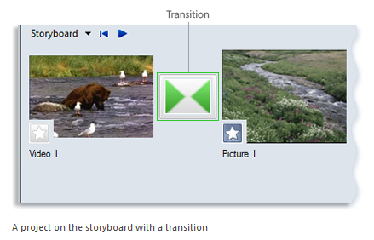
More Movie Maker magic
AutoMovie is the simplest way to add “wow” to your content. Once your photos and videos are in your project, clicking AutoMovie on the Home tab automatically adds crossfade transitions.

Slide 11
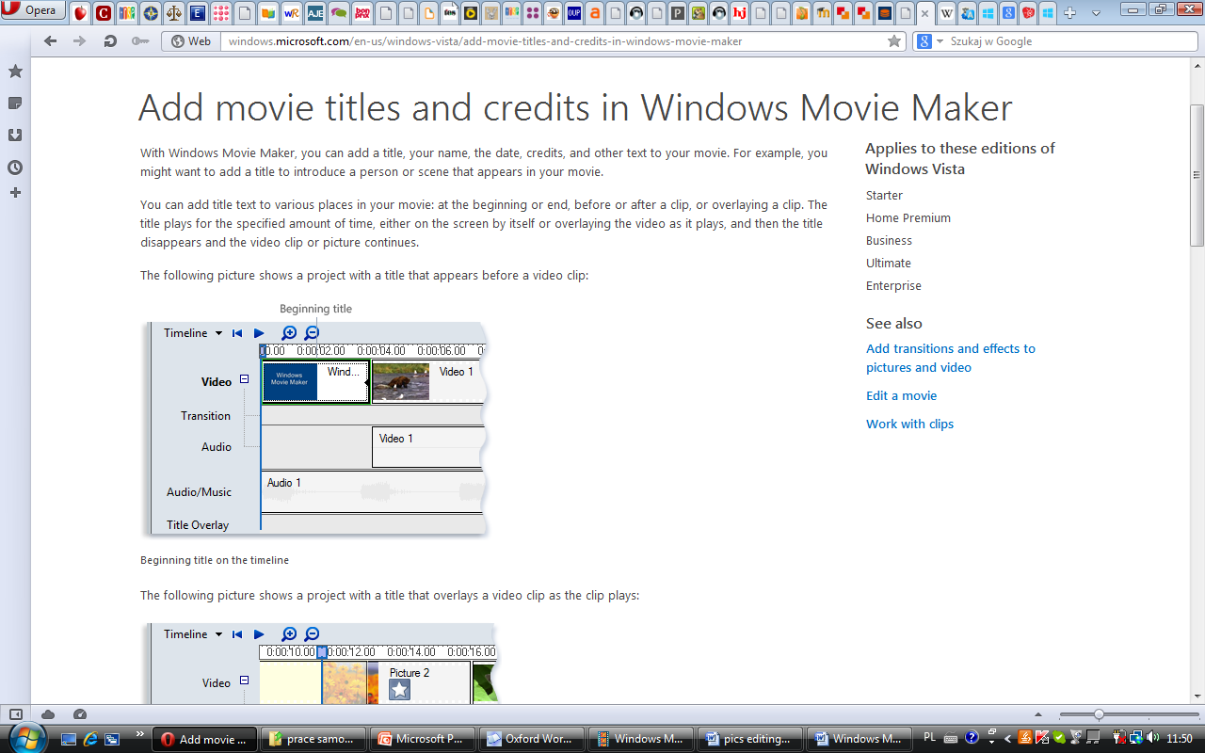
Titles, captions, and credits
Add titles, captions, and credits
Select the photo or video before which you’d see the title screen. Click the Title button on the Home tab of the ribbon. Enter your movie title in the area that states.

Slide 12
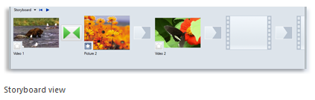
Storyboard
The storyboard is the default view in
Windows Movie Maker. You can use the
storyboard to look at the sequence or
ordering of the clips in your project and
easily rearrange them, if necessary.

Slide 13
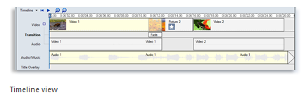
Timeline
The timeline view provides a more detailed
view of your movie project and allows you
to make finer edits. Using the timeline
view you can trim video clips, adjust the
duration of transitions between clips, and
view the audio track.

Slide 14
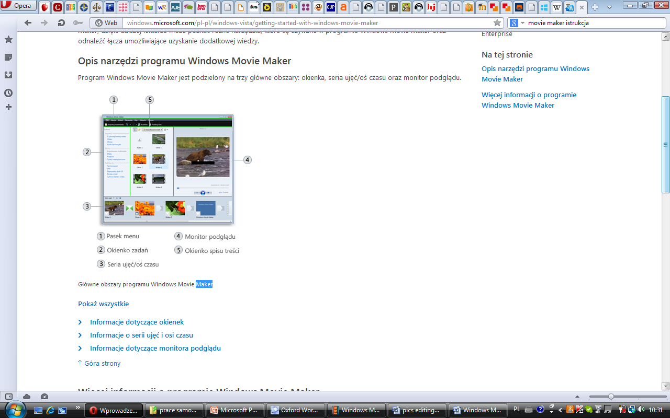
Preview monitor
The preview monitor allows you to view individual clips or the whole project.
By using the preview monitor, you can preview your project before publishing it as a movie.

Slide 15
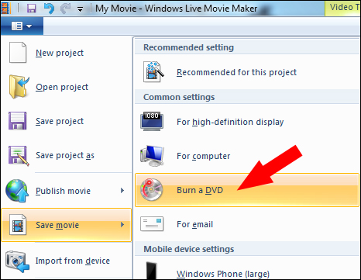
Last STEPS
Save your work
Use the pull-down menu on the left and select Save project to save your movie.
Burn a movie to a DVD
You can publish the project as a movie

Slide 16
THE END

