Slide 1
FAMOUS POLISH PEOPLE

Slide 2
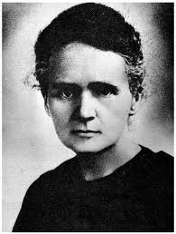
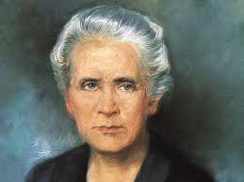
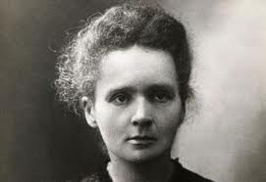
Maria Skłodowska – Curie
Marie Curie was born on 7th of November 1867.
She discovered two new chemical elements – Polon and Rad.
For her achievements she got two Nobel’s Prizes. One for her own work and the second for work, which she did with her husband (Pierre Curie) and a friend Becquerel.
She dead on 4th of July 1934.

Slide 3
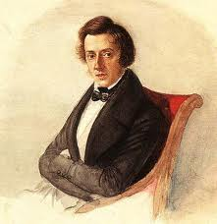
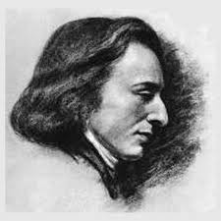
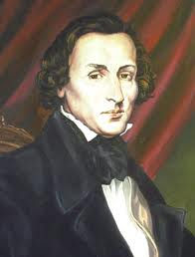
Fryderyk Chopin
Chopin was born on the 1st of March 1810 in Żelazowa Wola.
He was a very famous world known polish musician. He played on piano. He wrote some polonaises, mazurkas, etudes, etc.
He dead in 1849, in France.

Slide 4
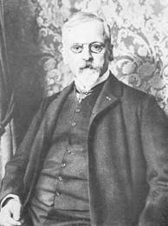
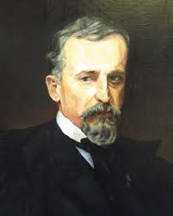
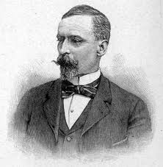
Henryk Sienkiewicz
He was born on the 5th of May 1846.
He was a famous polish author of many novels, e.g. Quo Vadis or Potop .
He got a Nobel Prize for his whole work.
He dead on the 15th of November 1916.

Slide 5
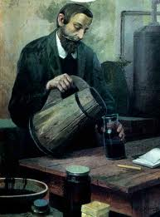
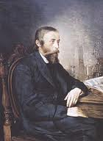
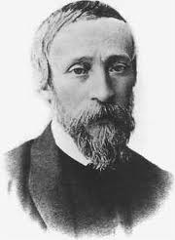
Ignacy Łukasiewicz
He was born in 1822.
He was an entrepreneur.
He is well known for his discovery - oil lamp in 1853 in Lwow.
He dead on the 7th of January 1882.

Slide 6
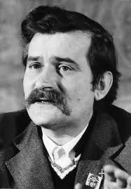
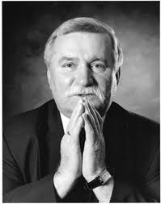
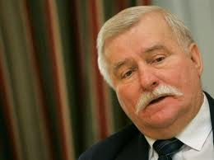
Lech Wałęsa
He was born on 29th of September in 1943.
He is a polish politician.
He took a big part in ,,Solidarność”.
He was a president in years 1990–1995.
He got The Nobel Peace Prize.

Slide 7
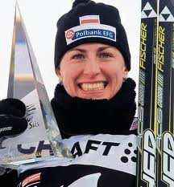
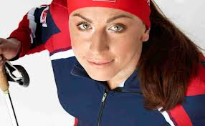
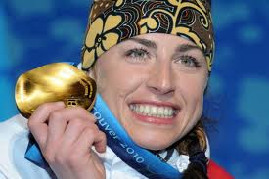
Justyna Kowalczyk
She was born on 19th of January in 1983.
She is a Polish cross country skier.
She is one of the most successful cross country skiers of all time.
She is a Olympic champion, twice world champion, a four-time Olympic medalist, winner of the World Cup (three times), four times winner of the Tour de Ski.

Slide 8
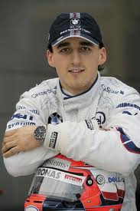
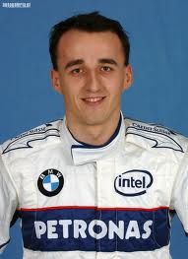
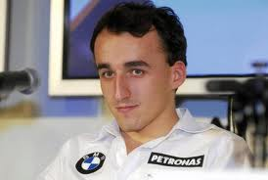
Robert Kubica
He was born on 7th of December in 1984.
He is famous Polish racing driver.
On 6 February 2011, Kubica was seriously injured in a crash at the Ronde di Andora rally.
In 2012, he was recognized as Man of the Year by the magazine "Top Gear„.

Slide 9
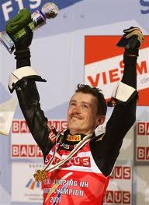
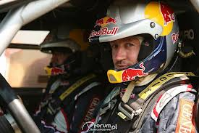
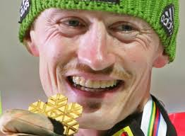
Adam Małysz
He was born on 3th of December in 1977.
Four-time Olympic medalist, four-time individual world champion, four times (including three times in a row) the winner of the World Cup, the Four Hills Tournament winner, three-time winner of the Nordic Tournament.
Now he is racing driver.

Slide 10
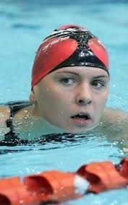
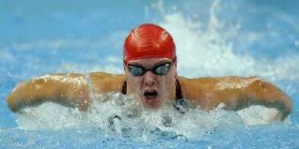
Otylia Jędrzejczak
She was born on 13th of December in 1983.
She is a Polish swimmer.
She is olympic champion, world champion, European champion, the triple world record holder, record holder in Europe.
Three times she was the best Polish sportsman.

Slide 11
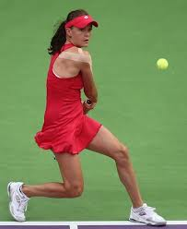
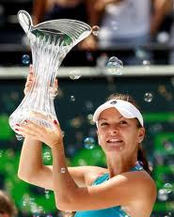
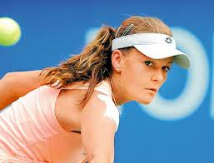
Agnieszka Radwańska
She was born on 6th of March in 1989.
She is Polish, female tennis player.
She is first Polish, female tennis player, who earned more than $ 1 million.
Her younger sister (Urszula Radwańska) is also playing tennis.

Slide 12
THANKS FOR YOUR ATTENTION

