Slide 1
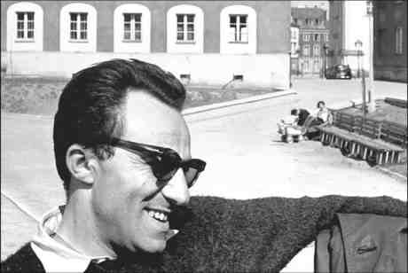
Szymon Szeliga 5B

Slide 2
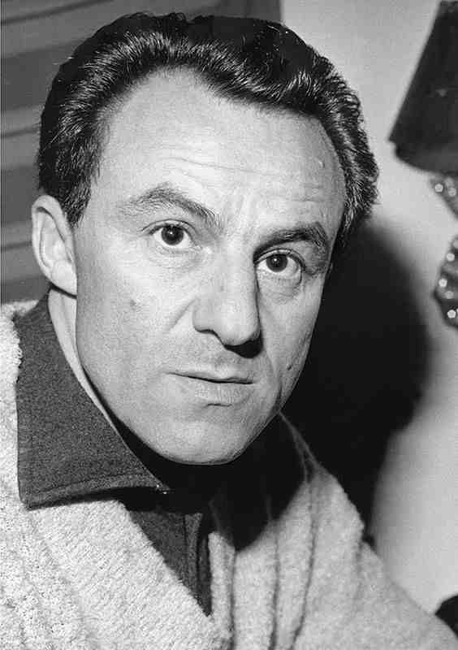
Andrzej Munk was born in October 1921. When he was a teenage boy, he went to science-natural secondary school. During World War II he took part in Warsaw Uprising. After the war he was studying at Warsaw University of Technology. But eventually he graduated from Film School in Łódź and he became a film director.

Slide 3
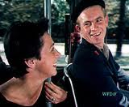
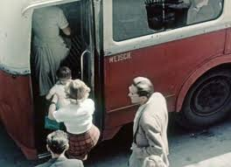
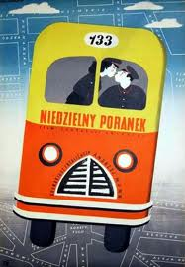
Firstly he was directing documentaries, for example, in 1955 „Sunday Morning”. This film shows from the perspective of a bus window typical day of typical Warsawer. Day to day life of Warsaw citizens was depicted in very funny way.

Slide 4
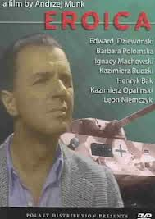
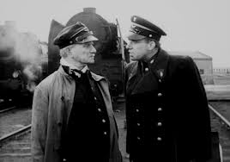
Then he started directing feature films. In 1956 he debuted with a drama titled „ A man on rails”. His next brilliant production was war film „Eroica”. The film consists of two parts: the first tells the story of the baby, who accidentally becomes a hero of the Warsaw Uprising. The second tells about the Lieutenant Zawistowski legendary escape from a German camp.
„A men on rails”

Slide 5
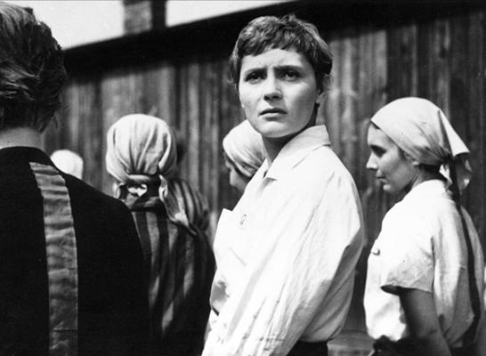
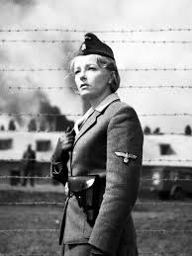
Andrzej Munk died in a car accident in 1961. Because of that he didn’t manage to finish his best film „Passenger”. This movie describes hard life at Nazi concentration camp during World War II. It also shows that not all Germans in the camps must be willing to torture people, for example by the main character Lisa, a guard of the camp. The last Andrzej Munk’s movie was finished by his co-workers.

Slide 6
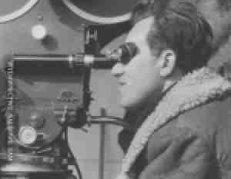
In 1965 there was established Andrzej Munk’s Award granted to the best debuting movie directors.

Slide 7
The end

