Slide 1

Tonsilitis
(Angina)

Slide 2
It’s a disease…
…Also known as inflammation of tonsils
…Giving you a high fever
…Which makes you cough
… Which makes your throat red

Slide 3
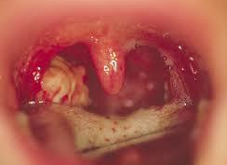
It looks like this

Slide 4
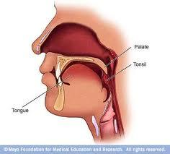
Or this

Slide 5
You can treat it with Paracetamol drugs and antibiotics. You also need to take cough and pain reducing drugs.
(Or go to the quack)

Slide 6
After having a Tonsilitis there are more chances of having glomerulonephritis (kłębuszkowe zapalenie nerek) and reumatical fever in the future

Slide 7
THANK YOU FOR WATCHING

