Slide 1
Phoenix

Slide 2
Members:
Thomas Mars (vocal)
Deck d’Arcy (bass)
Lauren Brancowitz (guitar)
Christian Mazzalai (guitar)

Slide 3
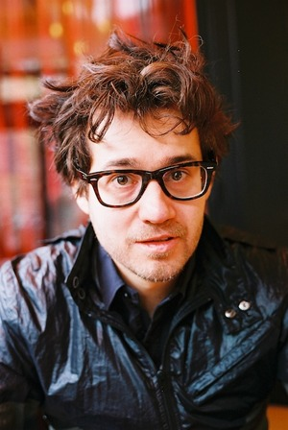

Slide 4
Discography:
United (2000)
Alphabetical (2004)
It’s never been like that (2006)
Wolfgang Amadeus Phoenix (2009)

