Slide 1
Our School’s Traditions
Primary school no 24
Social and Educational Society

Slide 2
Our school year
Our school year consists of four parts
Each part has a name, for example this part (the second one) is called „Big dreams of a little feet”
After each part there are two big tests – one from English and one from Polish language, Nature Studies, Maths and History.
After each part we also get „big” marks

Slide 3
Math Competition
Every year our school make also an on-line math competition, called „Move your head”
It consists of four parts too
Every part is make of 6 exercise – if you do 3 of them you will get 1 point, but if you do all of them you will get 6 points
At the end of school year there is an award for people who will get most points

Slide 4
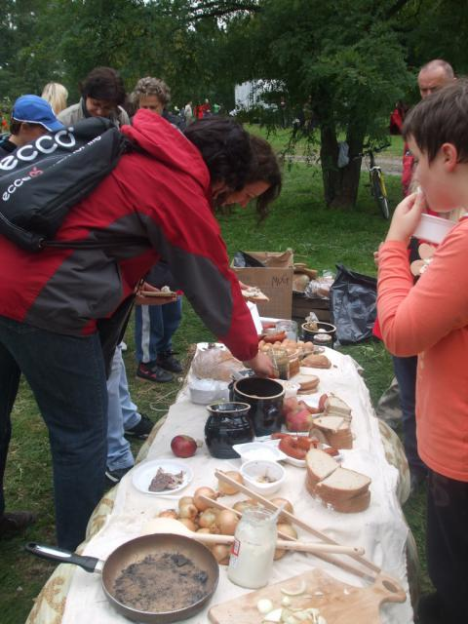
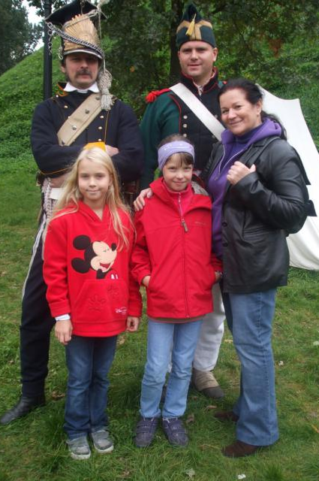
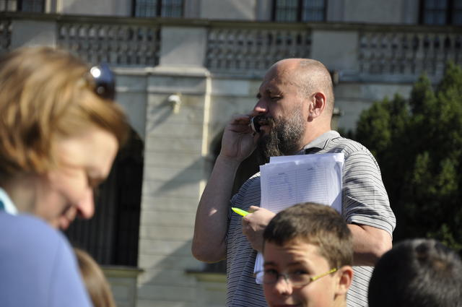
Family rally
It takes place twice a year – in Autumn and in Spring
It always has some topic for example „Palaces of Warsaw” or „Warsaw on rails”
Teams are made of parents and children
Its participants must walk around Warsaw, visit some points on which teachers and students prepares some exercise for them
They also must do handouts where are questions that need to give a written answer
Anwers to all questions are in places which are marked on map

Slide 5
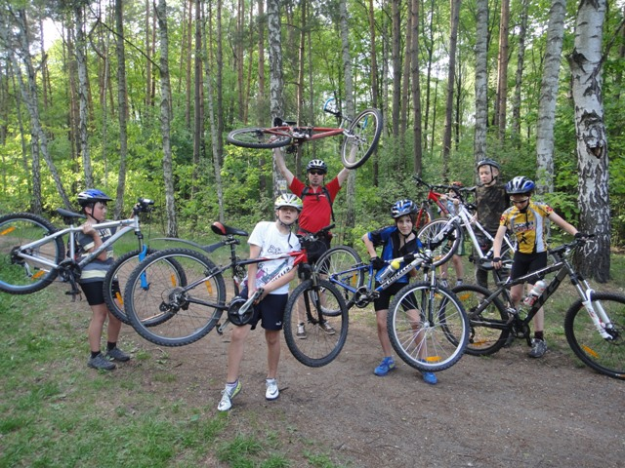
bike and motorbike cart
In September students from classes 4-6 can pass a test for bike and motorbike cart
A man from ……….. is coming to our school and carries out training, and then test
The same man have come to our school for …… year
Many people every year pass exam and we can go for many bikes tripes

Slide 6
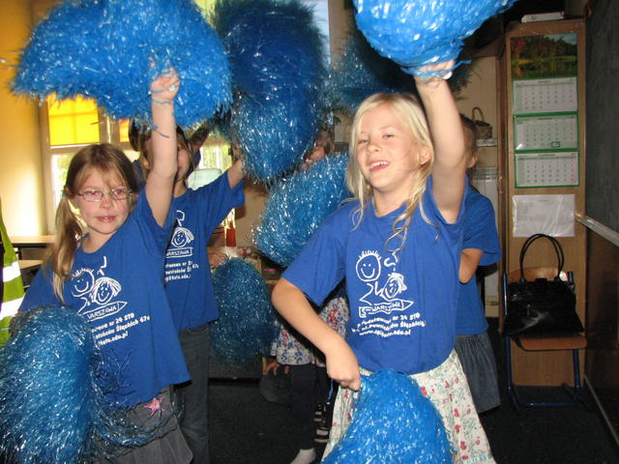
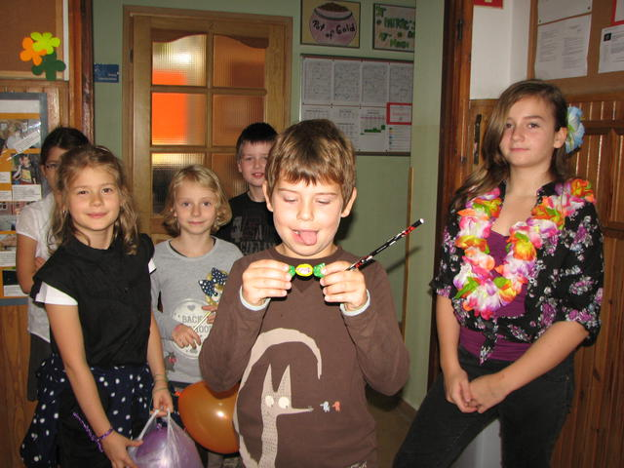
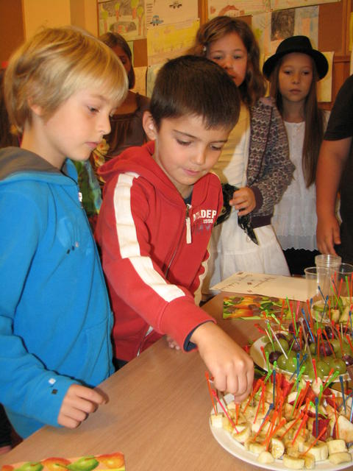
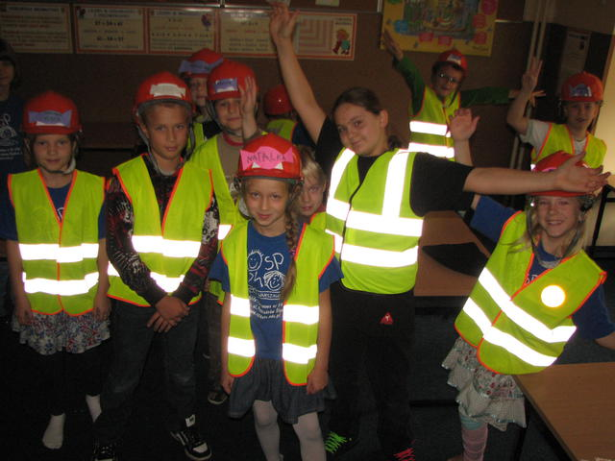
Initiation ceremonies
In September our school officially adopts its doors new students
All classes prepared wonderful points on which new students can try many different sweets, visit a hairdresser, go back in time, visit chocolate factory, take part in a play etc.
At the end new people choose the best class and get their legitimating but befor that they must eat lemon with smile
That’s really great fun!

Slide 7
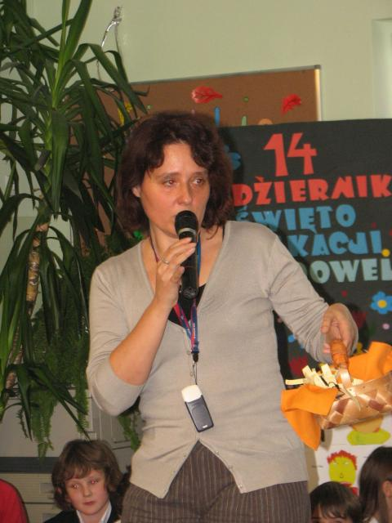
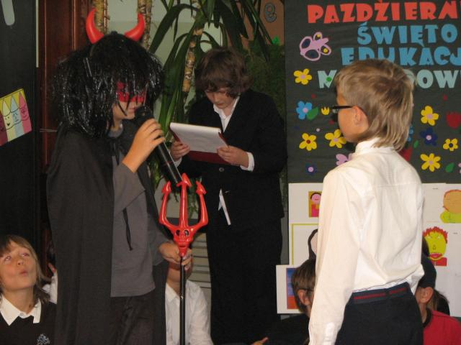
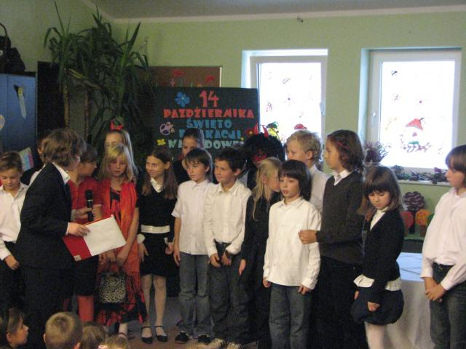
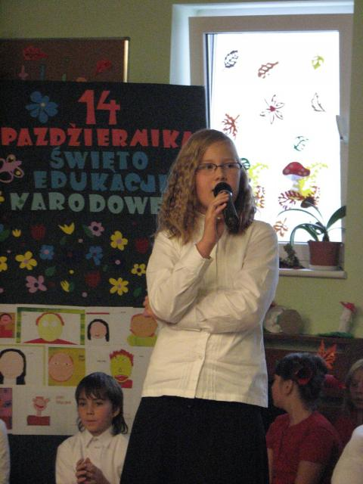
National Education day
On 14th of October Poland celebrate National Education Day called also Teacher’s Day
In our school it is preparing by 4th classes
They can make a play for the whole school or only for teachers
They also make some presents for teachers for example cookies or bookmarks
We often have an appeal on this day

Slide 8
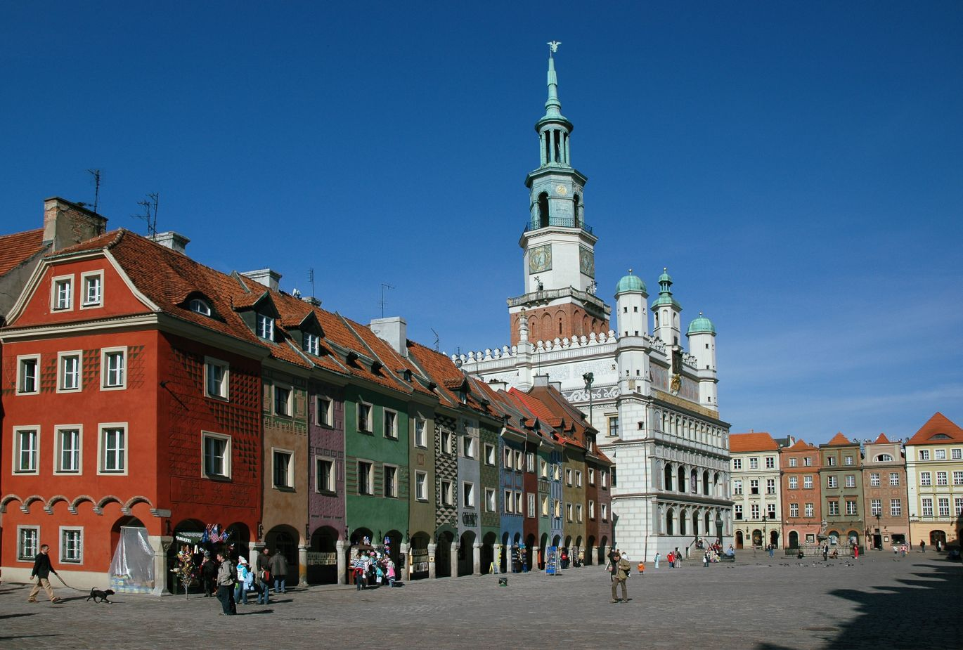
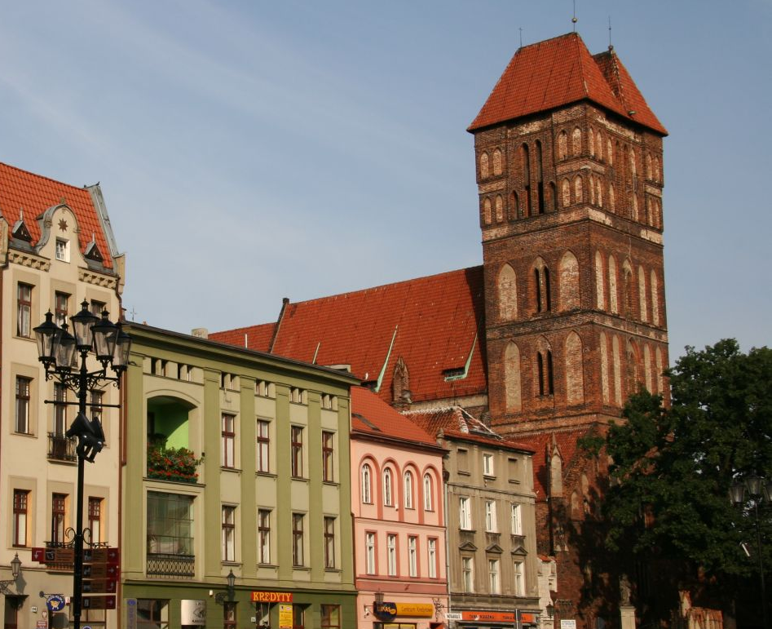
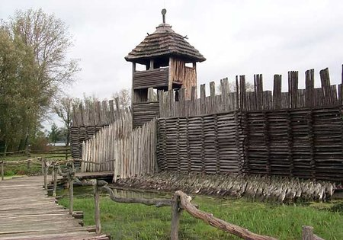
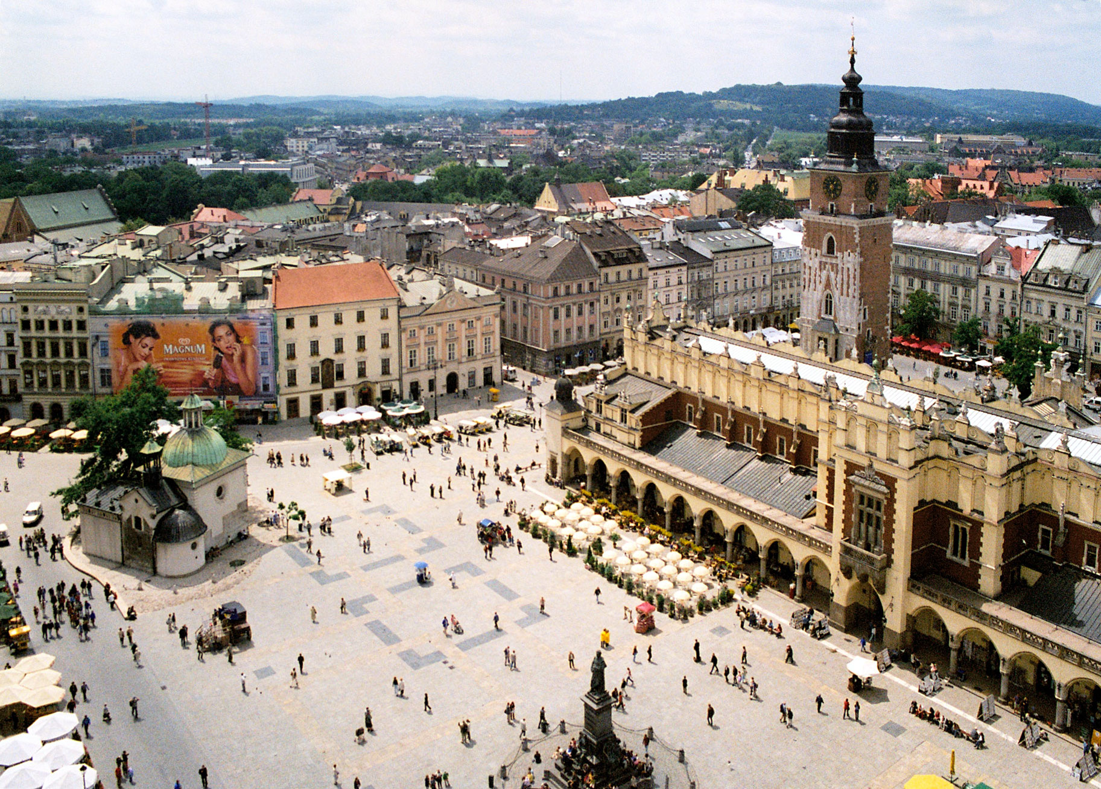
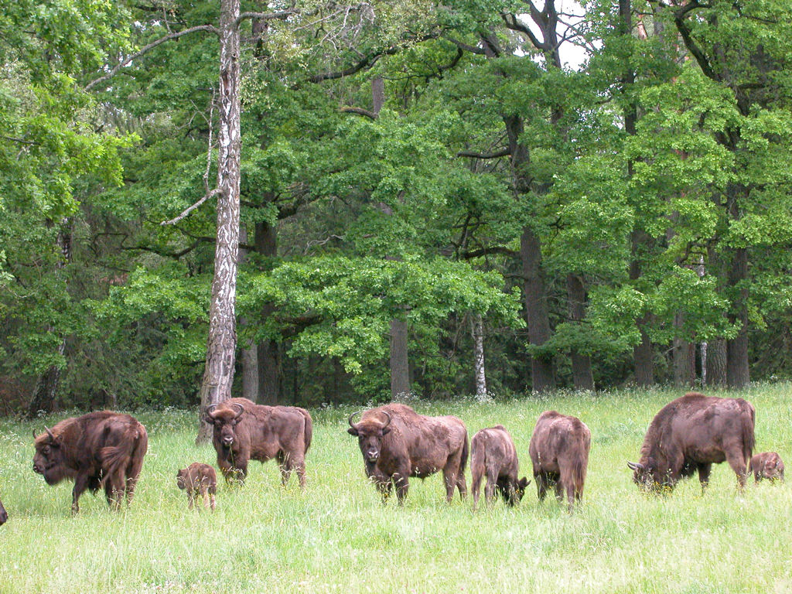
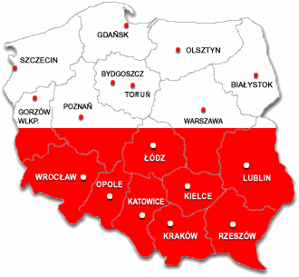
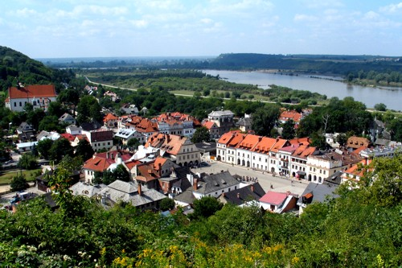
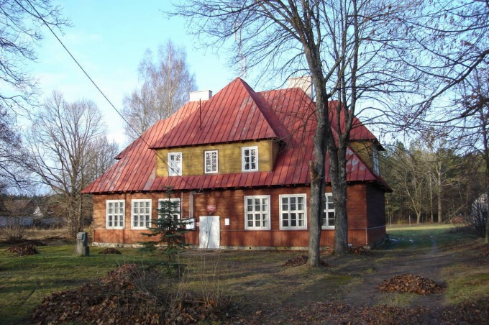
Trips around Poland
Every year in September or October all classes are going on some trip:
1st class go to Bialowieza
2nd class go to Kazimierz Dolny
3rd class visit Torun and Biskupin
4th class come to Rudawka
5th class go to Poznan
6th class visit Cracow
On this tripes we are visiting palaces, castels, churches, museums etc. It’s great.

Slide 9
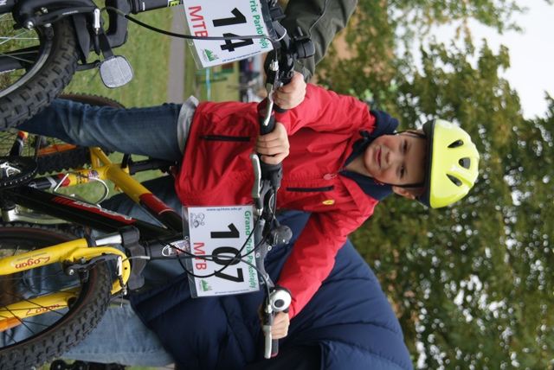
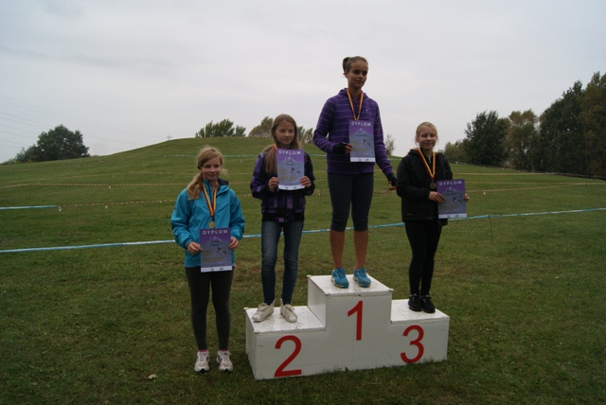
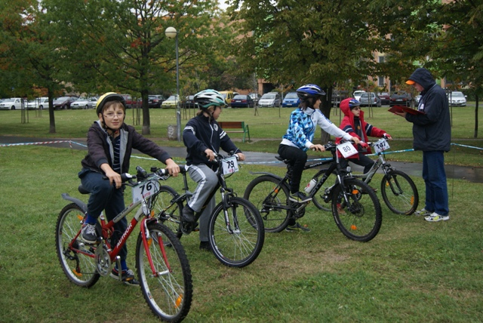
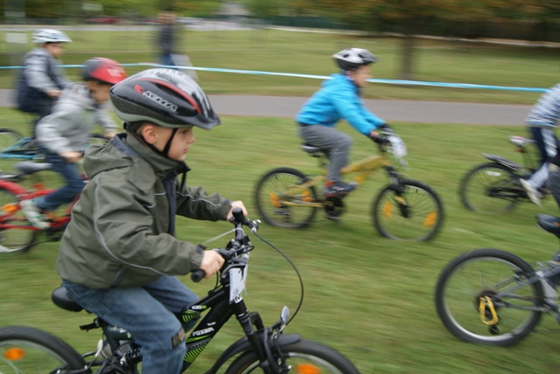
Grand Prix of Parkofrajda
It is a bike race around hill, which is near our school. People from 5 to 99 years old can take part in it.
It took place two times a year
People in the same age start race in the same time (girls and boys didn’t ride together), so there are about 10 categories
All people who has got 1st, 2nd or 3rd place get a medal and a diploma

Slide 10
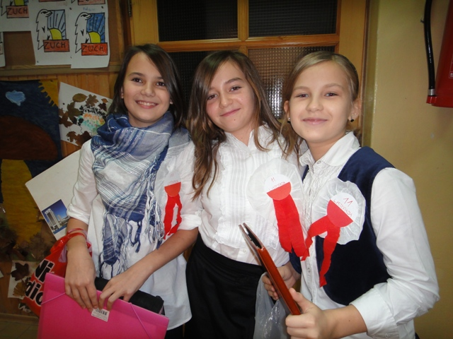
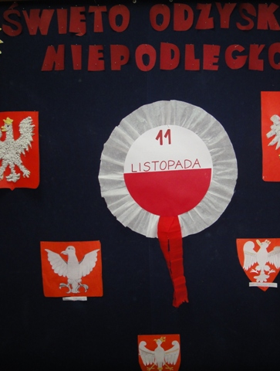
Independence day
Every year students from 6 classes prepares Independence Day which is on 11th of November
Independence Day is in Poland very important day because it’s an anniversary of independence after 123 year of slavery which took place in XVIII-th and XIX-th century
For example in this year we were going around all classes and telling them about this day

Slide 11
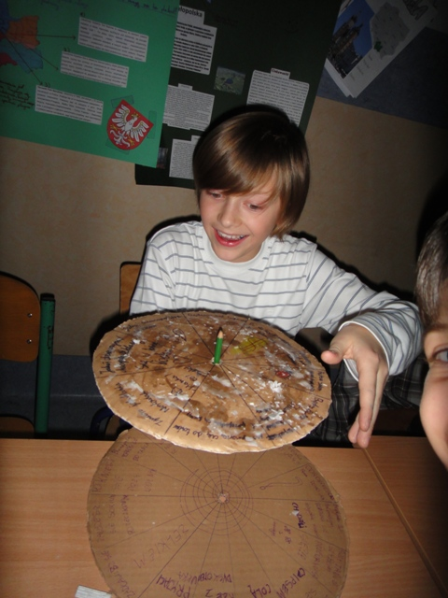
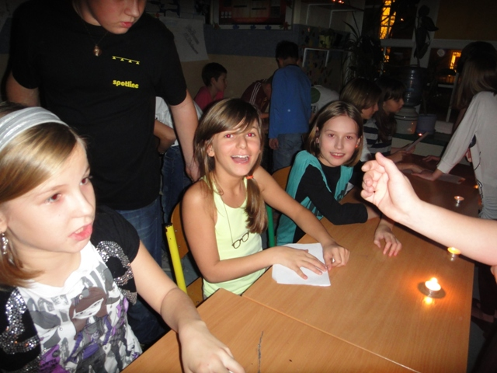
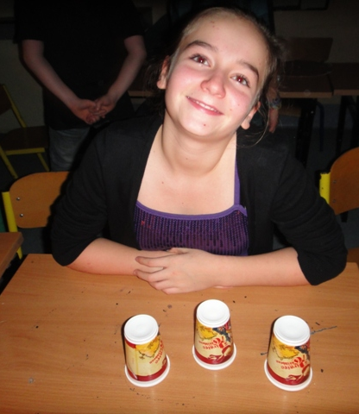
St. Andrew Disco
We foretell many things to each other on it
Every year near 30th of November in our school is St. Andrew Disco
If you come on this party you will know name of your wife/husband, your job, what mark of car you will have, what dress you will have on your wedding etc.
After foretoken we have disco and treat

Slide 12
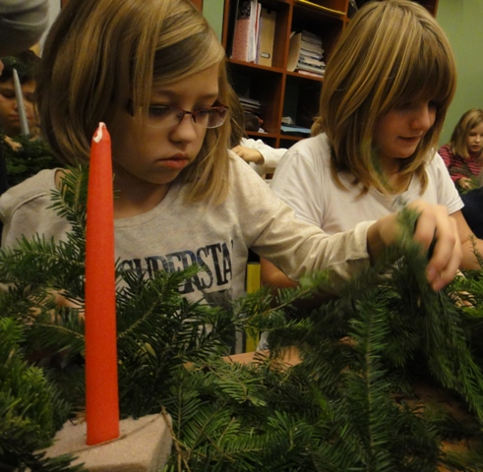
Class’ Christmas Eve
Last day at school before Christmas break all classes from our school have their own Christmas dinner
Students bring to school cakes, salads and other dishes
Then we are sitting near decorated table and eat together

Slide 13
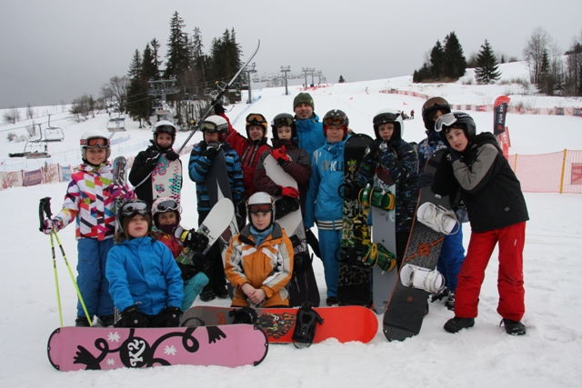
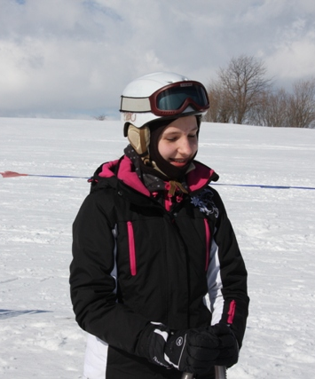
White School
Every year in December or January volunteers go on the White School
White School take place in Bialka Tatrzanska, which is at south part of our country, in the mountains
Students are learning how to skiing, snowboarding, cross – country skiing, skating etc.
It takes one week
Then in March there are a competition from winter school

Slide 14
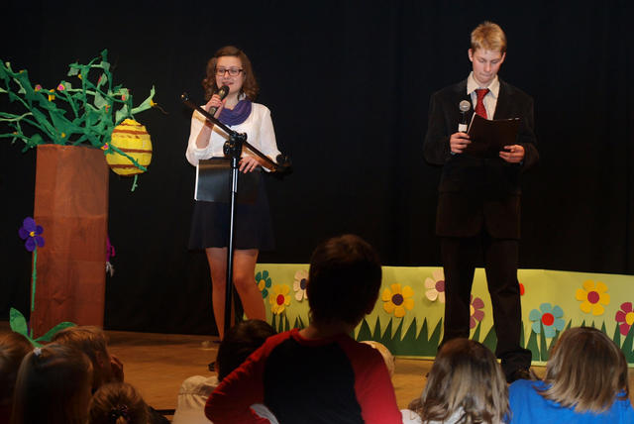
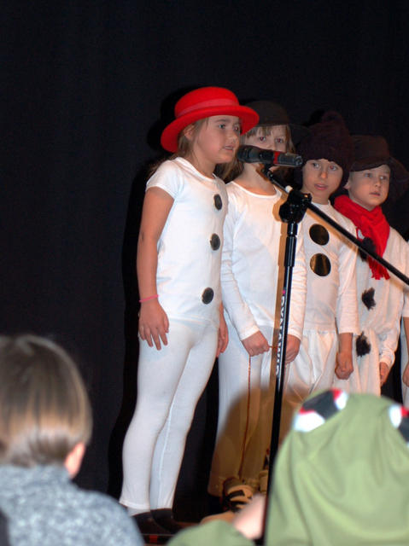
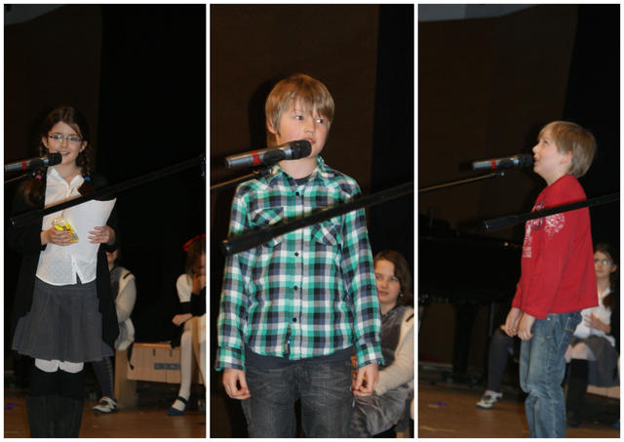
New Year’s Concert
New Year’s concert is very important day at school
All classes 1-3 prepares some play or they are singing some songs and telling some poems
There are people who sings alone
Our students are also telling about our school, about new projects etc.

Slide 15
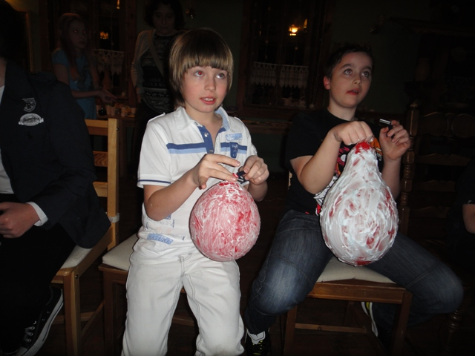
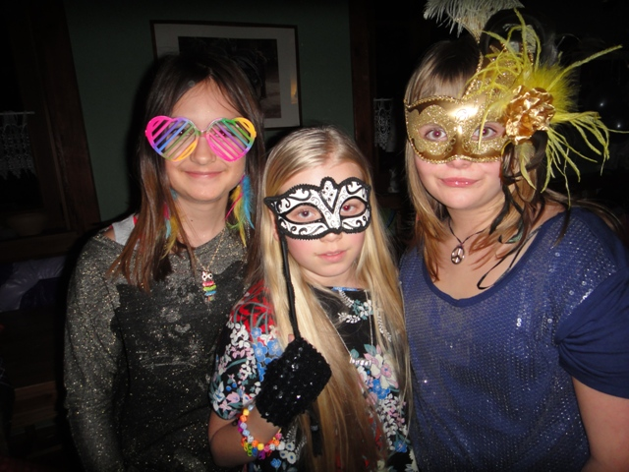
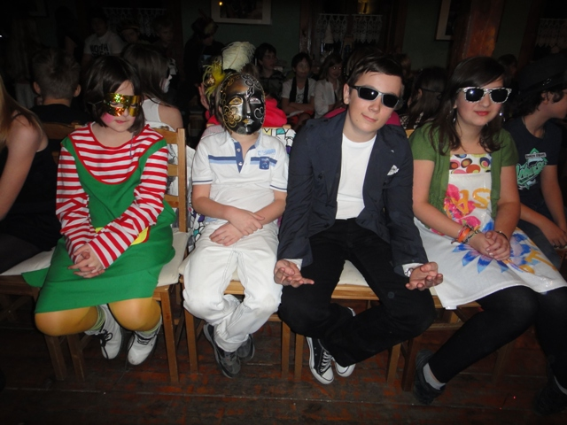
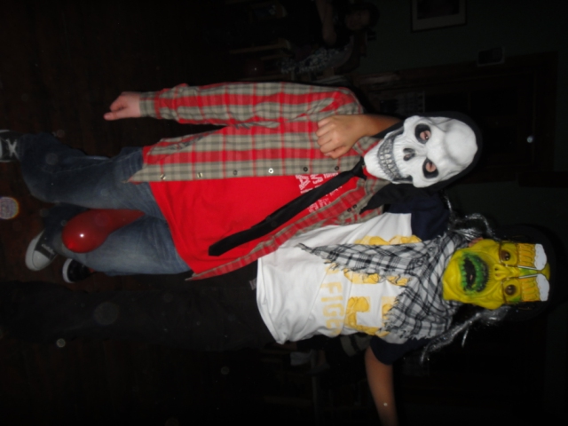
Carnival Bal
During carnival volunteers from classes 4 – 6 leave their houses for one night because they go for party!
All balls has got some topic, for example „Stars” or „Daub”
It has generally taken place in Stara Dabrowa
We leave school and go there by coach. We are there on about 6 pm, we eat sapper, process in disguise and then dance to morning
During the party we’ve got many games
On the next day we come back to Warsaw

Slide 16
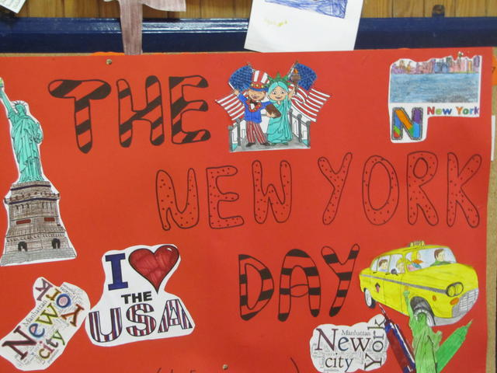
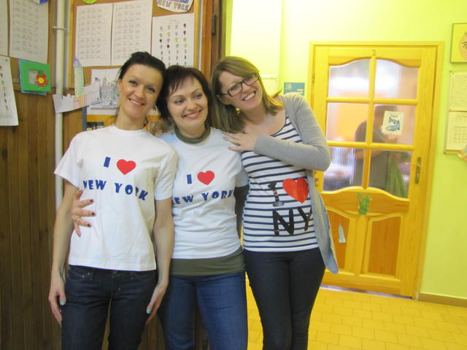
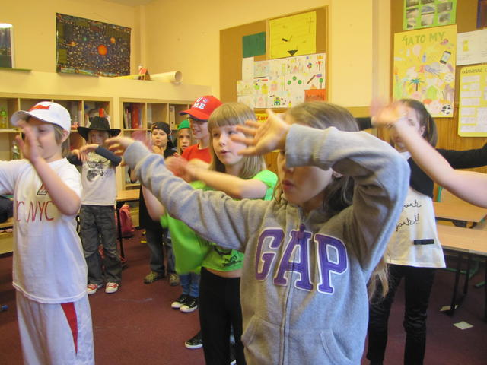
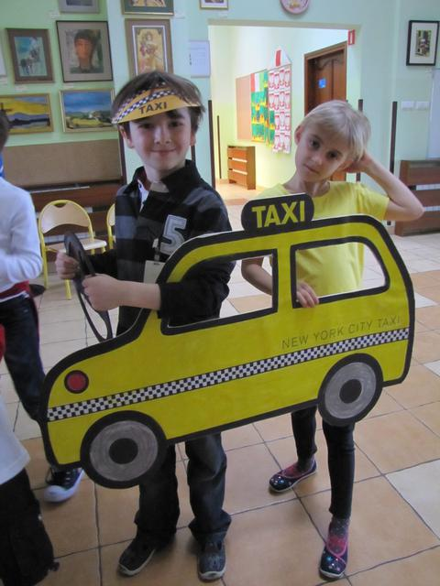
English- Language day
On the 21st of March we’ve got very special day in our school
Students from class 6 and teachers are preparing English – language day for all school
On this day each class must go around points in school on which it must to do some exercise and collect as many points as it can. On this points classes must dance, sing, fill the gaps in the text etc.
We’ve already had American, English, Scott and Africa day.
Class, which win get some prize

Slide 17
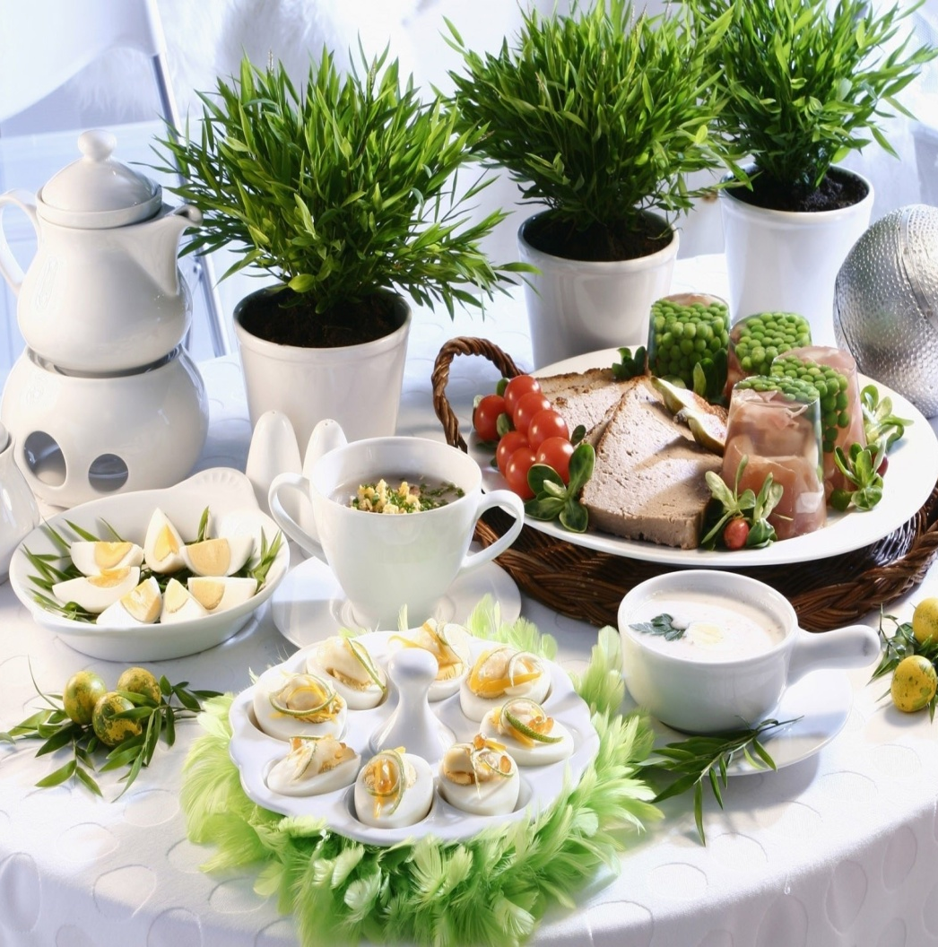
Class’ Easter breakfast
As before Christmas on the last day in school before Easter break all class have got their Easter Breakfast
All people from class prepare something to eat or to decorate classroom
Then we eat together, egg share and nicely spent time

Slide 18
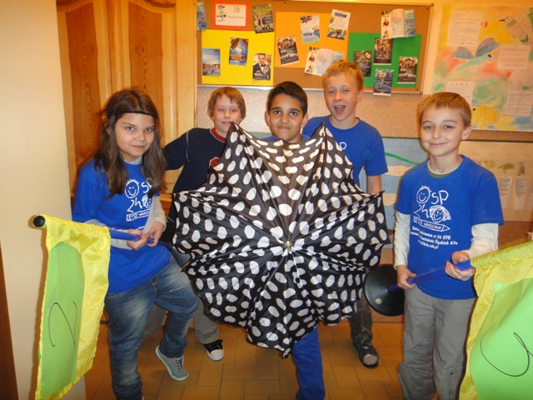
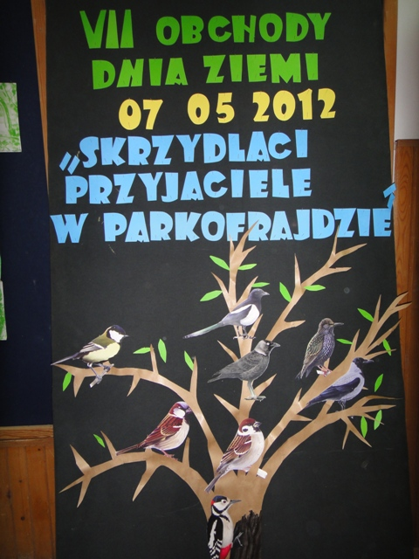
Earth day
Near our school, in the park called Parkofrajda, every year in April or May is the Earth Day. It’s consists of game for class 0-3 and a picnic
During the game students must go around some stations and collect points. They can get points for answer questions, do some tasks etc.
On the picnic you can go to stations on which you can get prizes for answering questions. You can also climb on the climbing wall, play team games, ride on fire engine etc.

Slide 19
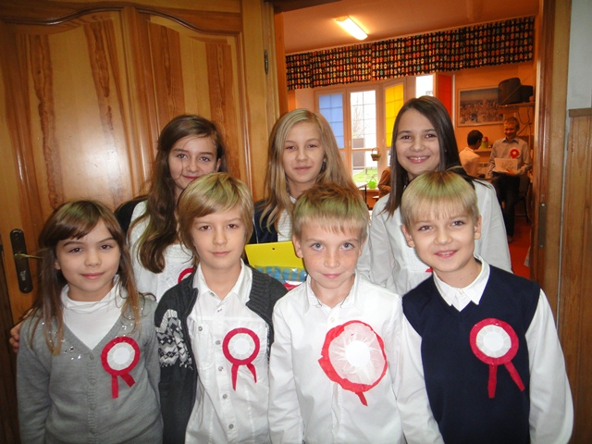
Constitution day on 3rd May
Constitution Day on 3rd May is second very important day in Poland which we celebrate
Students from class 5 prepare this day
As on Independence Day they go to some classrooms and talking about the history of this day

Slide 20
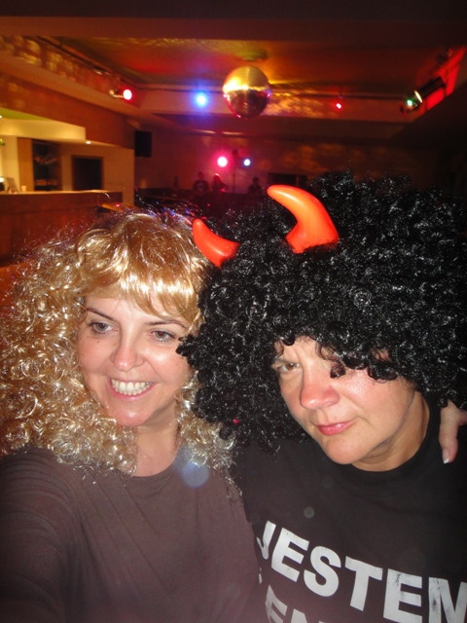
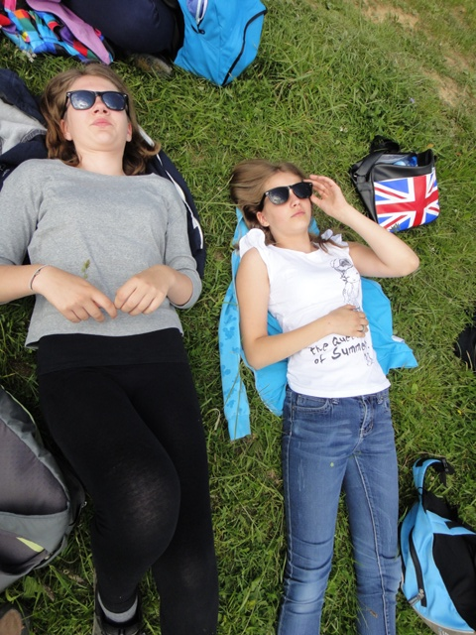
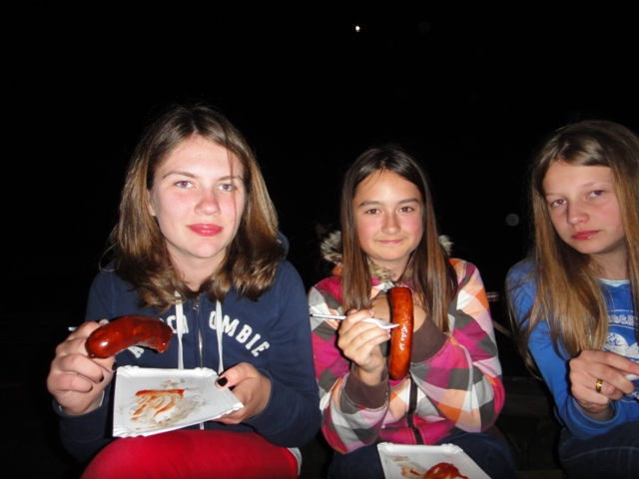
Green School
In May or June students from all school are living their houses for more than 5 days
We are going on the trips to some places in Poland
During green school we have many trips, games, discos, bonfires etc.
At the last day at green school all school take part in game prepared by teachers. Teams are make of students from all classes 1-6. They must collect points and having great fun

Slide 21
School’s day
The last big event in our school is the School’s Day
It takes part in June and always has some topic for example: „Japan” or „Once a folkloric”
During this day students with their families can see how people live in some parts of the world. For example during day called „Once a folkloric” you could met food, hobbies, work, customs, dances and dress of people from the countryside. It was funny and interesting.

Slide 22
Thanks for your attention
Julianna Piskorz 6b

