Slide 1
Christmas time in Poland
Karolina Ćwikła

Slide 2
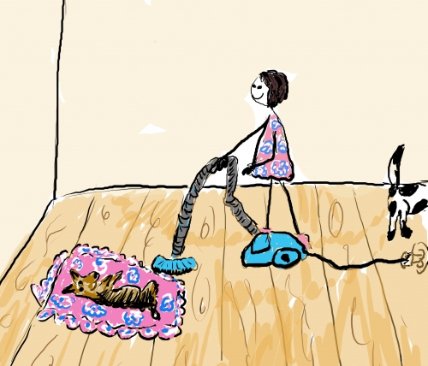
Before Christmas we clean our houses.

Slide 3
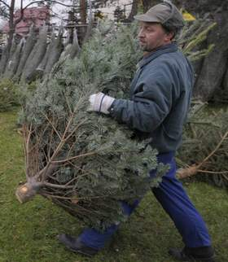
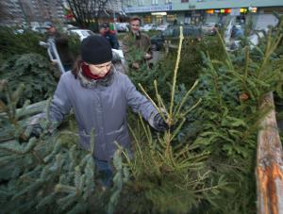
Later we go to buy a Christmas tree.

Slide 4
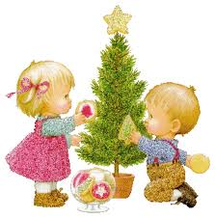
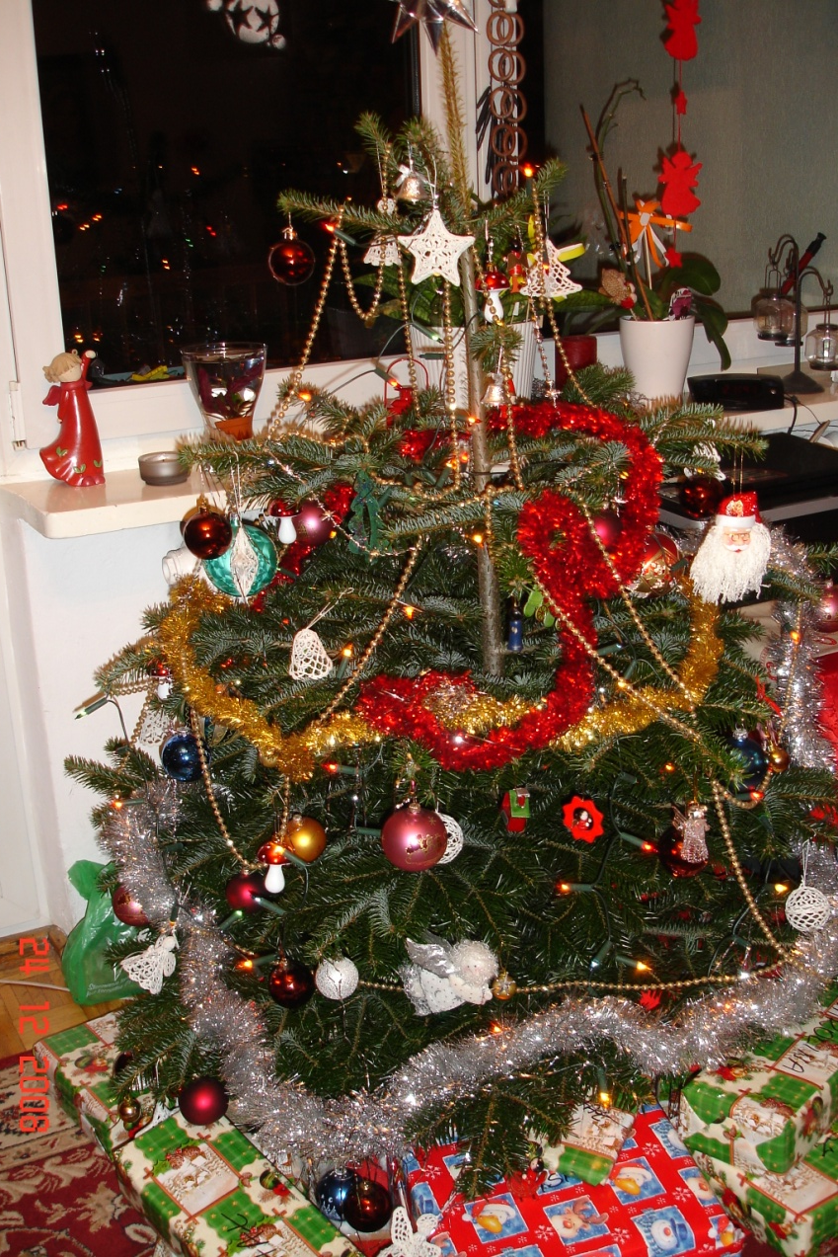
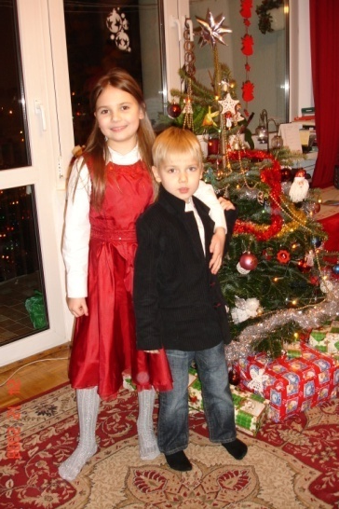
We put our Christmas tree at home and decorate it.

Slide 5
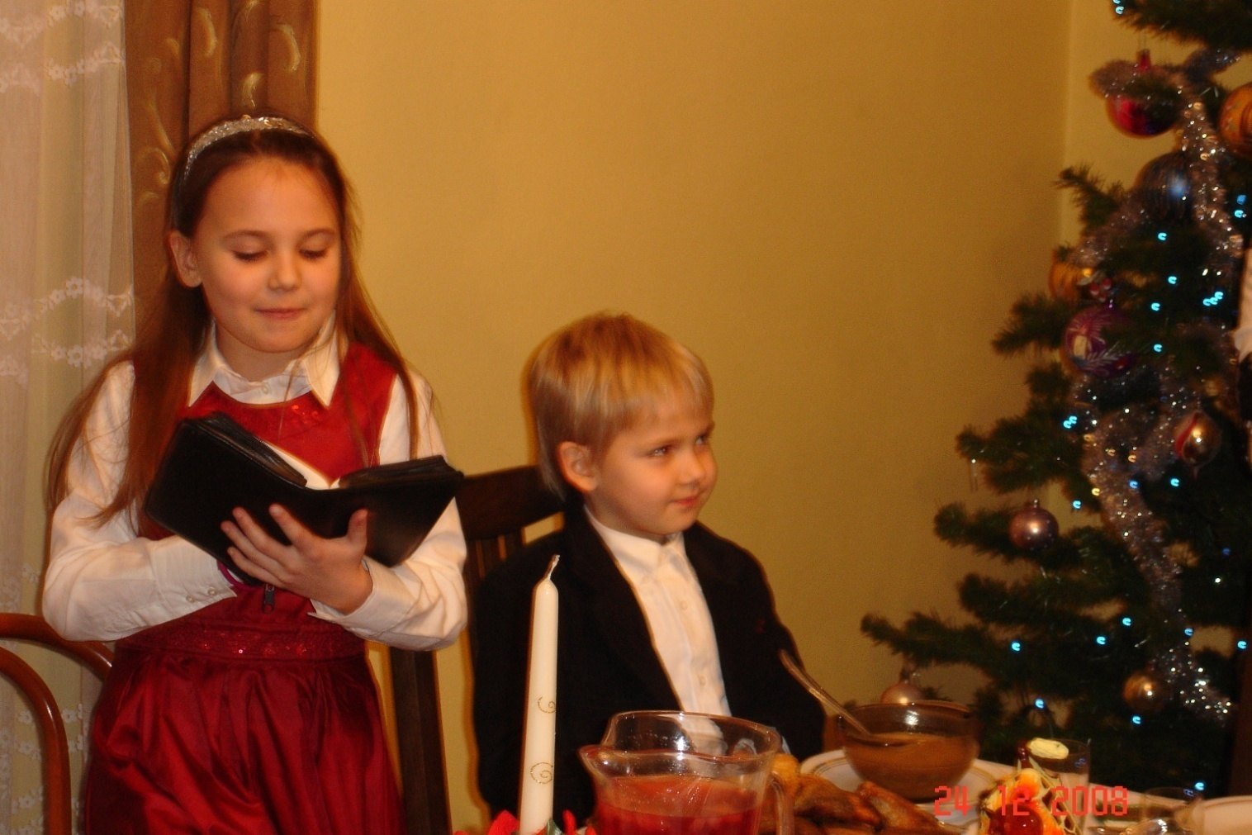
At Christmas Eve we meet at my grandmother’s house. At the beginning of the supper one person reads the Bible.

Slide 6
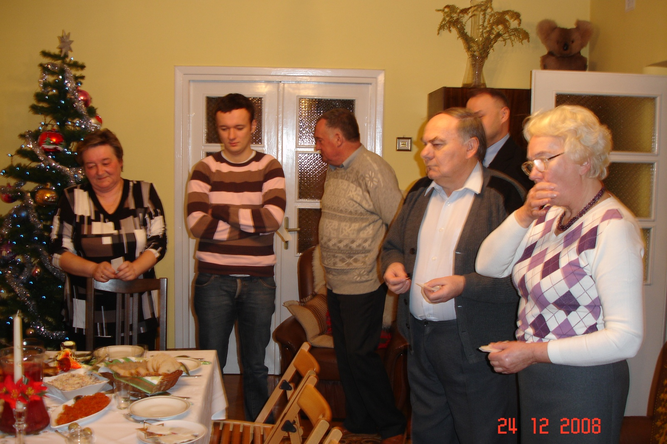
After Bible we divide the wafer and wish everyone Merry Christmas. Everyone also must try twelve Christmas dishes.

Slide 7
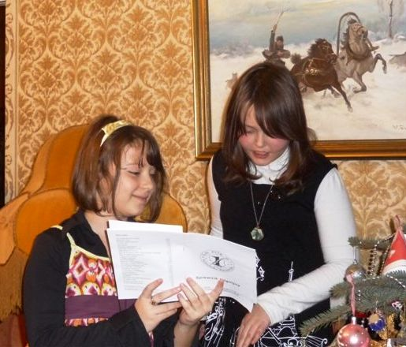
During Eve supper we also sing Christmas carols.

Slide 8
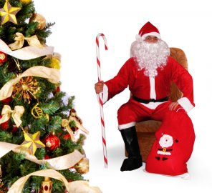
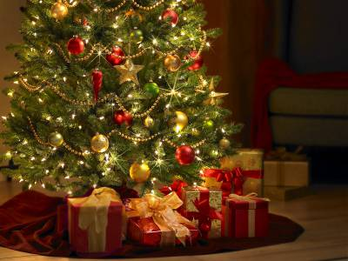
Later we open presents which Santa Claus put under Christmas tree.

Slide 9
Thank you for your attention.

