Slide 1
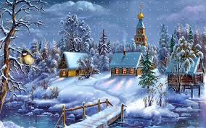
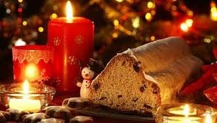
Christmas food

Slide 2
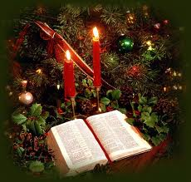
Catholic families normally start their Christmas Eve supper with a prayer followed by the ceremony of sharing a wafer.

Slide 3
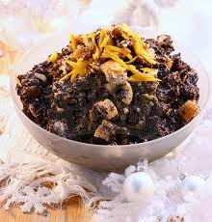
MAKIELKI
Makielki is an old traditional Polish Christmas Eve dish. It contains poppy, noodles, raisins and delicacies.

Slide 4
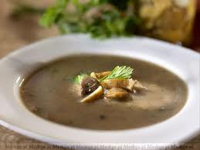
MUSHROOM SOUP
One of the typical Christmas Eve dishes is mushroom soup. It is made of both fresh and dried mushrooms. It is usually finished with cream and served with hand made noodles.

Slide 5
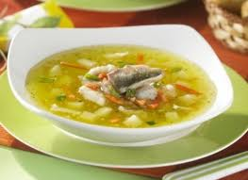
Another special Christmas Eve soup is the fish soup, which is made of carp. One finishes it with cream and serves with noodles.

Slide 6
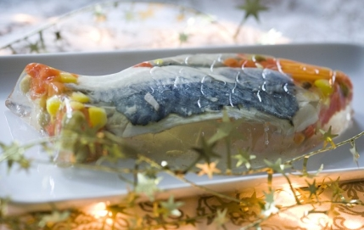
CARP
The carp is a major Christmas Eve special main course. It is served in a jelly on a long plate.

Slide 7
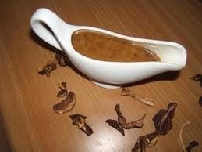
MUSHROOM SAUCE
Mushroom sauce can be prepared both with dried and fresh mushrooms. If you like its delicate taste, it is better to use fresh mushrooms. Dried mushrooms give it a more intensive taste.

Slide 8
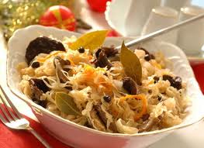
CABBAGE WITH MUSHROOMS
Cabbage with mushrooms is also very typical of Polish Christmas cuisine.It is usually served in a bowl.

Slide 9
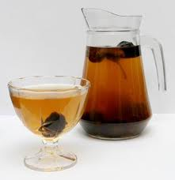
COMPOTE
Dried fruit compote is also commonly served at Christmas Eve supper.

Slide 10
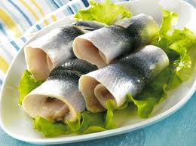
HERRING
Herrings are usually served with cream or oil sauce with onions.

Slide 11
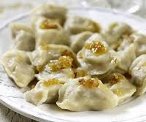
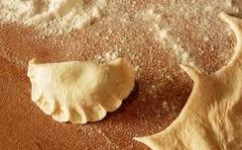
DUMPLINGS
Dumplings is a traditional Polish dish. They are noodles stuffed with cabbage and mushrooms.

Slide 12
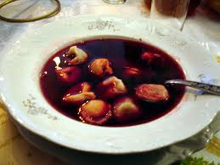
BARSH
Barsh is also a very common Christmas dish. It is made of beetroot. We serve it with stuffed noodles.

Slide 13
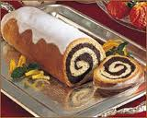
POPPY SEED CAKE
A poppy seed cake is the most popular Christmas Eve dessert. It is baked with raisins.

