Slide 1
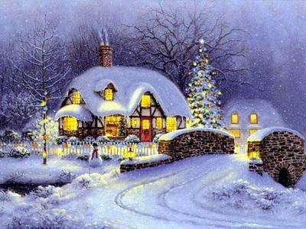
Marysia Wołyniak
CHRISTMAS
IN POLAND

Slide 2
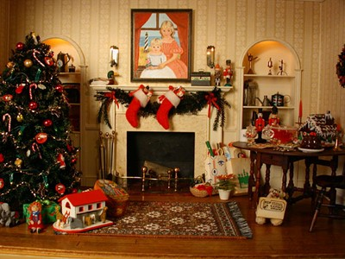
Preparations
The preparations for Christmas begin many days before the actual celebration. Nearly everywhere women are cleaning windows in apartments and houses just before Christmas. The insides of the houses are also cleaned thoroughly. It is believed that if a house is dirty on Christmas Eve, it will remain dirty all next year.

Slide 3
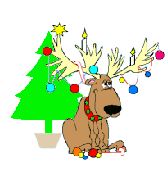
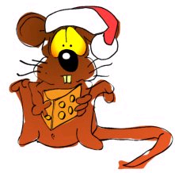
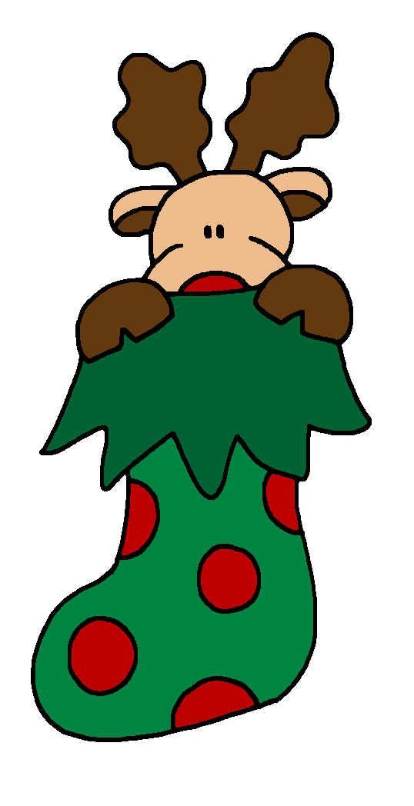
Ceremonies
Some ceremonies take place before the Christmas Eve supper (Wigilia). Among farmers, a popular ritual is the blessing of the fields with holy water and the placing of crosses made from straw into the four corners. It is also believed that animals can speak with a human voice.

Slide 4
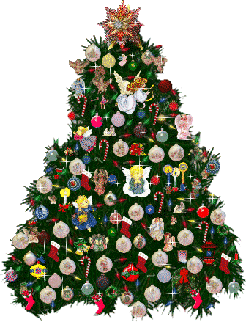
Christmas tree
Traditionally, the Christmas tree is decorated on the Wigilia day - quite an event for children.
The Christmas tree is adorned with apples, oranges, candies and small chocolates wrapped in colorful paper, nuts wrapped in aluminum foil, hand-blown glass ornaments, candles or lights, thin strips of clear paper (angel's hair), and home-made paper chains. The latter, however, has become rarer because commercially produced aluminum foil chains are being sold.

Slide 5
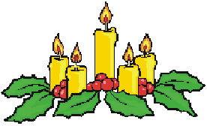
Wigilia
It is still strongly believed that whatever occurs on Wigilia (Christmas Eve) has an impact on the coming year. So, if an argument should arise, a quarrelsome and troublesome year will follow. In the morning, if the first visiting person is a man, it means good luck; if the visitor is a woman, one might expect misfortune. Everyone, however, is glad when a mailman comes by, for this signifies money and success in the future. To assure good luck and to keep evil outside, a branch of mistletoe is hung above the front door. Finally, old grudges should end. If, for some reason, you do not speak with your neighbor, now is the time to forget old ill feelings and to exchange good wishes.

Slide 6
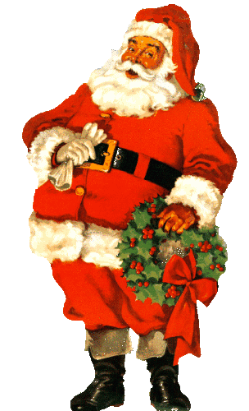
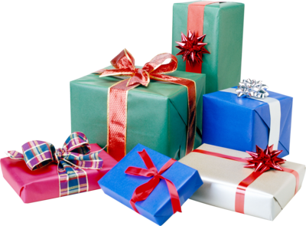
Santa Clause
Christmas and Santa Claus Day are not celebrated at the same time in Poland, but rather three weeks apart. Santa Claus (called Mikolaj) Day is celebrated on December 6th, the name day of St. Nicholas. This is when St. Nicholas visits some children in person or secretly during the night.

Slide 7
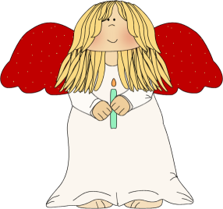
Wigilia (Christmas Eve)
Straw is put under white tablecloth. Some maidens predict their future from the straw. After supper, they pull out blades of straw from beneath the tablecloth. A green one foretells marriage; a withered one signifies waiting; a yellow one predicts spinsterhood; and a very short one foreshadows an early grave.

Slide 8
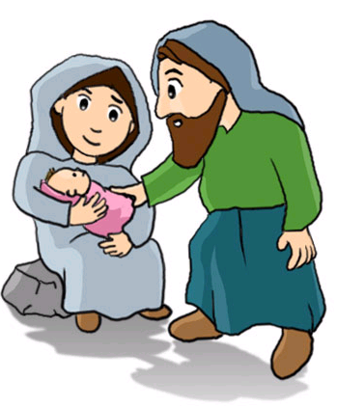
Wigilia (Christmas Eve)
In Poland, an additional seat is kept for somebody unknown at the supper table. No one should be left alone at Christmas, so strangers are welcomed to the Christmas supper. This is to remind us that Mary and Joseph were also looking for shelter. In Poland, several homeless people were interviewed after Christmas. Some of them were invited to strangers' houses for Christmas; others that were not asked inside the homes but were given lots of food.

Slide 9
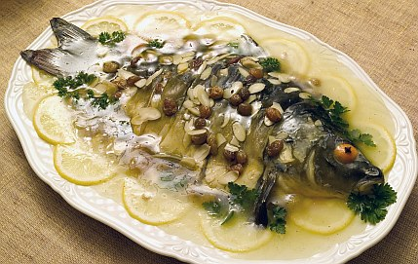
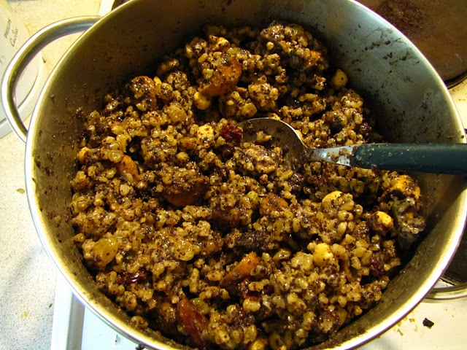
Wigilia Table Check List
Here's a short list of foods typically found on the Polish Christmas Eve Wigilia table. Because practices vary from region to region within Poland, this guide is not a definitive list but rather a handy reminder for those of you who wish to keep this tradition alive in your family.
Mushroom soup with noodles, borsch with mushroom uszka (little pierogi), or fish soup.
Herring in oil, pickled herring, carp aspic (jellied carp), stuffed carp, and/or fried carp.
Hay under the white tablecloth.
Salt, pepper.
Sauerkraut with mushrooms, and/or red cabbage.
Dried-fruit compote.
Noodles with poppyseeds.
Kutia (a dish made from boiled wheat, poppy seeds and honey).
Pierogi, traditionally with cabbage and mushrooms.
Oplatek (Christmas wafer).
Bread
An extra setting for an unexpected wanderer
Oplatek (Christmas wafer).
stuffed carp
Kutia

Slide 10
Kolendy – Christmas Carols
The Polish Christmas carol or koleda is derived from the Latin word Calendae, meaning "first day of the month". Polish Christmas carols are almost all anonymous, having been composed by the people. Their origins date from the fourteen century, and many from the sixteenth and seventeenth centuries. W Zlobie Lezy, believed to have been composed in the fourteenth century, is considered to be the first Polonaise.

Slide 11
Merry Christmas !!!!!

