Slide 1
Primary School No 24 of Civic Educational Associacion
Warsaw, Bemowo District
www.sp24sto.edu.pl

Slide 2
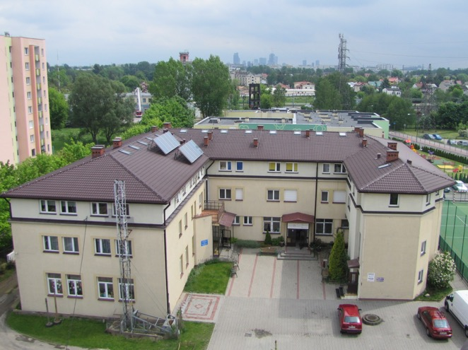
Basic information
Independent School
Founded in 1990.
Located in Bemowo District, Warsaw, Poland
22 classes
16-18 pupils in each
(over 400 pupils in total)
Pupils aged 6-14
70 teachers

Slide 3
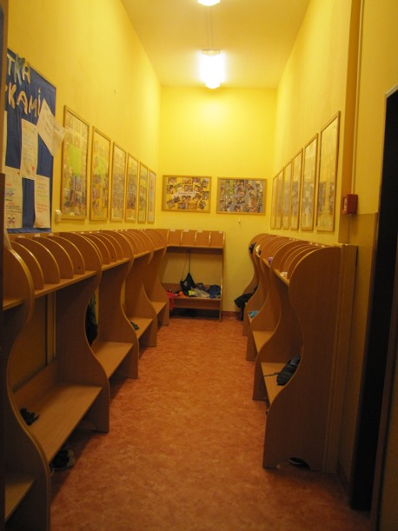
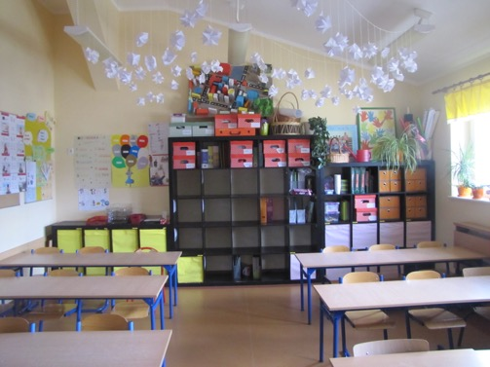
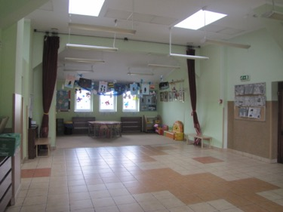
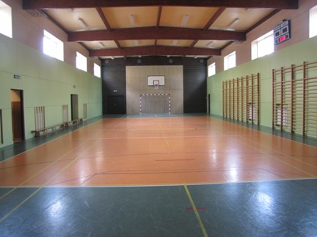
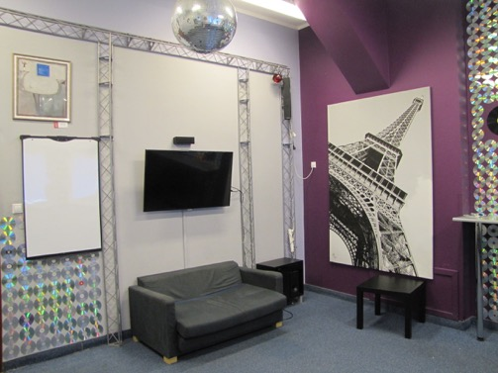
School

Slide 4
History
founded by parents in 1990, after the political transformation in Poland
created from the need to provide children with better standards of education:
formed to offer learning:
- in smaller groups,
- with cooperative teachers,
- in friendly atmosphere

Slide 5
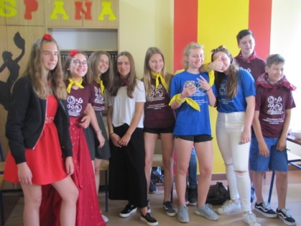
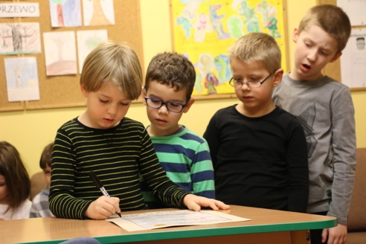
Our mission is based on personal skills development
a sense of responsibility
kindness and cooperation for one another with the use of active learning methods
self-determination and independence in every day decision-making and goals choosing

Slide 6
Day at school
Aged: 7-9 | Aged: 10-12 | Aged 13-14
5 classes every day (per week: 17 classes with the class teacher, 3 English classes, 2 religious classes, 3 sport classes) | 6 classes every day (per week: maths, Polish language, science, history, English, art, sport, religion) | 7 classes every day (per week: maths, Polish language, biology, chemistry, physics, history, English, art, sport, religion)
Lunch break (1 hour) | Lunch break (1 hour) | Lunch break (1/2 hour)
Extra curricular classes - an array of activities ranging from art, science, maths, sport – different disciplines to craft. | Extra curricular classes - an array of activities ranging from art, science, maths, sport – different disciplines to craft. | Extra curricular classes - an array of activities ranging from art, science, maths, sport – different disciplines to craft.
Opening hours: 7.15 a.m -6.00 p.m | Opening hours: 7.15 a.m -6.00 p.m | Opening hours: 7.15 a.m -6.00 p.m

Slide 7
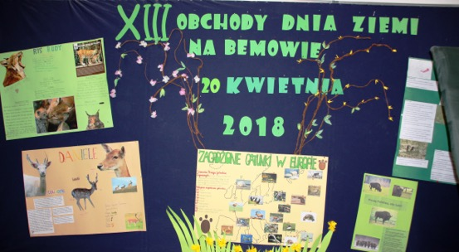
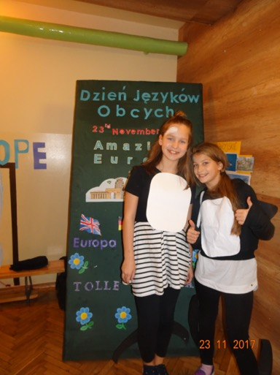
School Events
The Day of Foreign Languages (Nov)
The New Year Concert (Jan/Feb)
The Earth Day (April)
The School Celebration Day (Jun)

Slide 8
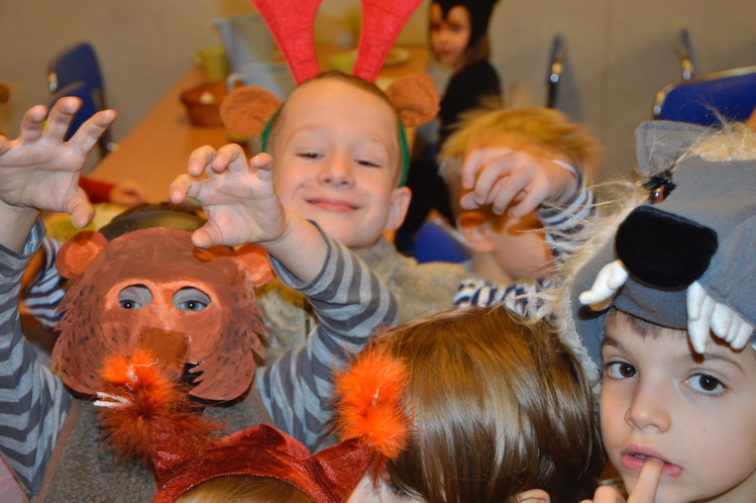
The Day of Foreign Languages (Nov)
annual school quizzes
another theme every year
teachers, pupils engagement
prepared and presented by 7th grade classes
fancy dress party

Slide 9
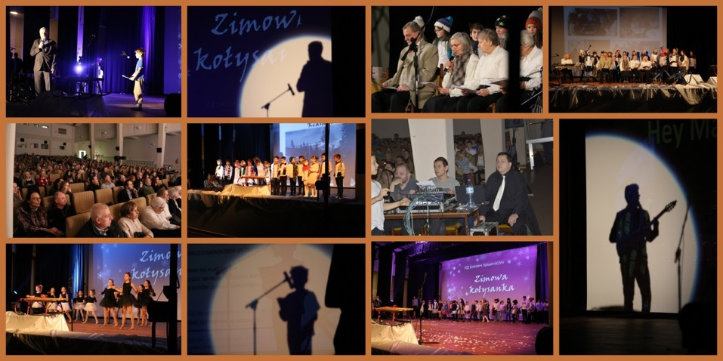
The New Year Concert (Jan/Feb)
annual performances
another theme every year
teachers, parents, pupils engagement
in cooperation with culture institutions

Slide 10
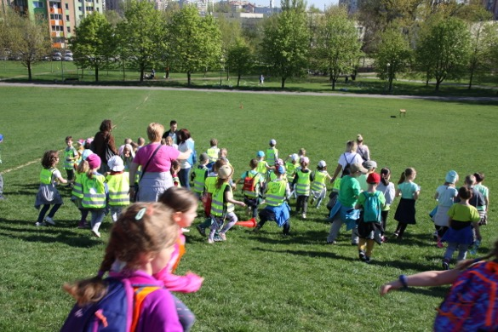
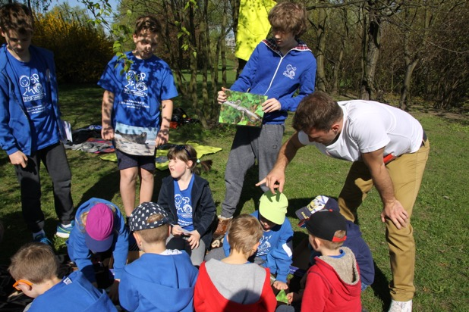
The Earth Day (April)
annual festival and treasure hunt game
different environment-related theme each year
other schools from the same district involved
prepared and performed mostly by pupils themselves

Slide 11
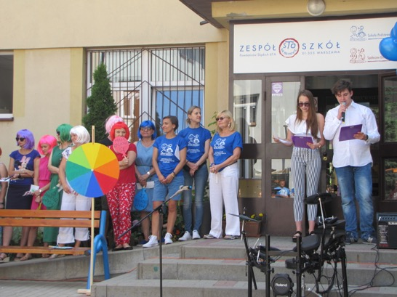
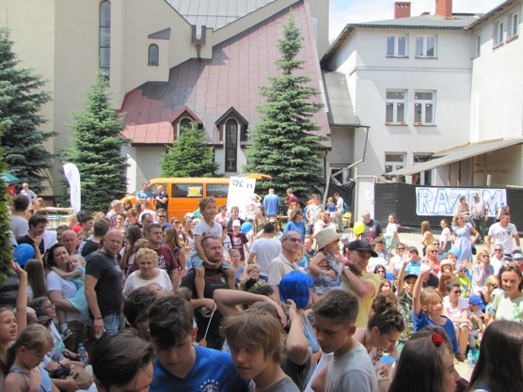
The School Celebration Day (Jun)
annual celebration
school’s all year work presentation
another theme every year
teachers, pupils, parents, institution engagement
prepared and presented by teachers and students

Slide 12
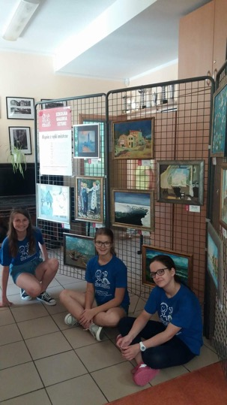
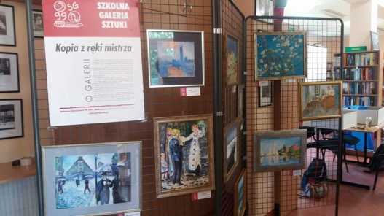
The School Art Gallery
annual activity
art masterpieces copied by students
around 400 works (Van Gogh, Picasso, Mucha, Munch)

Slide 13
Ewa Pytlak - ewa.pytlak@sp24sto.edu.pl

