Slide 1
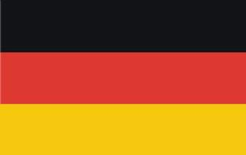
Germany

Slide 2
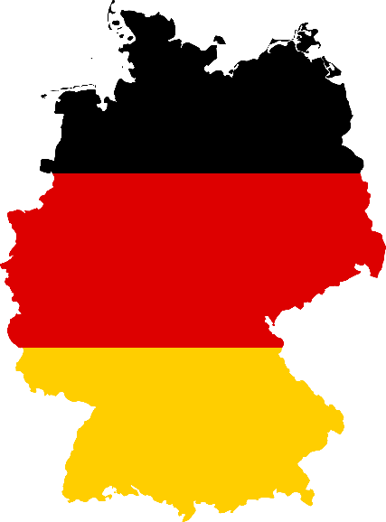
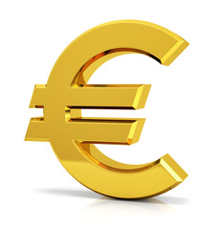
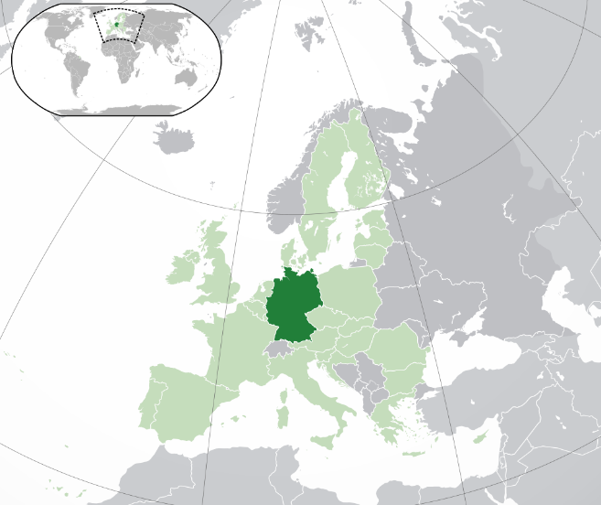
Basic information
Population-about 81 million people
Area-357375km2
Currency-euro €
Capital-Berlin
Location-center Europe
Drives on the right

Slide 3
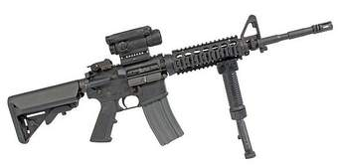
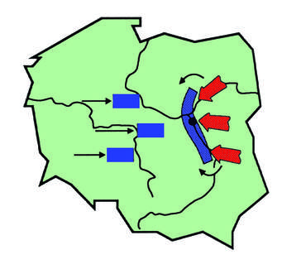
History
Germany began - year 800.
Germany lost in WWI-1918.
Germany attacked Poland-the begin of WWII-1st September 1939.
Germany lost in another World War, this time WWII-8th May 1945.
Germany split into 2 countries-1949
Western Germany joined to NATO in 1955 and it was one of the initiators of EEC
Germany united into 1 country -1990

Slide 4
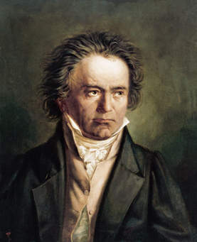
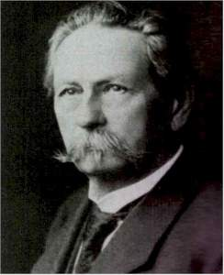
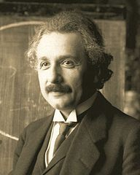
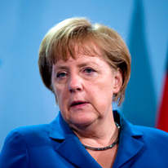
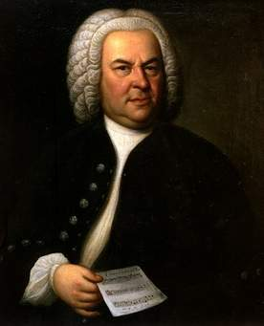
Famous Germans
Johann Sebastian Bach-composer
Martin Luther-theoliogian
Albert Einstein-scientist
Karl Benz-enginner
Ludwig van Beethowen-composer
Angela Merkel-chancellor

Slide 5
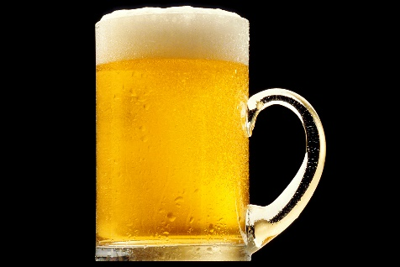
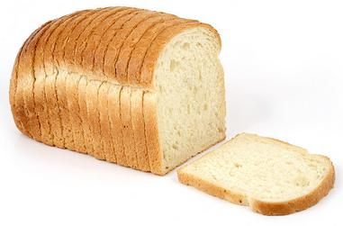
Curiosities
Germans are the second biggest consumers of beer in the world.
The most popular German surname is
Müller.
There are over 300 kinds of bread in Germany.
There are over 1000 kinds of sausages in germany.
Berlin is 9 times bigger than Paris.

Slide 6
Thank you for your attention !!!!!!!!
Konrad Kędzierski 6B

